Slide 1
MKIDS: Progress and Prospects
Jonas Zmuidzinas
Caltech

Slide 2
Team
Caltech
  Nicole Czakon, Ran Duan, David Moore, Omid Noroozian, Tasos Vayonakis, Tom Downes, Matt Hollister, Larry Beirich, Sunil Golwala, Jonas Zmuidzinas
JPL
  Jack Sayers, Bruce Bumble, Peter Day, Rick Leduc, Hien Nguyen, Phil Wilson
Colorado
  James Schlaerth, Phil Maloney, Jason Glenn
UCSB
  Sean McHugh, Ben Mazin & group
NIST
  Jiansong Gao
+ collaborators

Slide 3
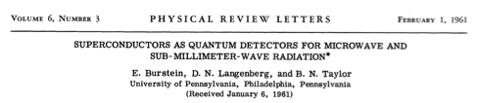
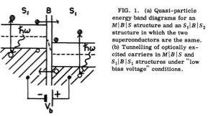
1961: STJ detector proposed

Slide 4


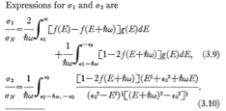

1958: Mattis & Bardeen
absorption
emission
Pair breaking
Kinetic inductance

Slide 5
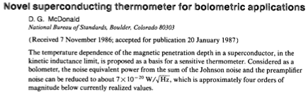
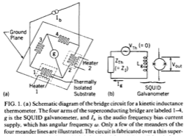
1987: Kinetic Inductance Thermometers

Slide 6

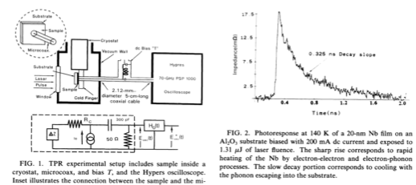
Bluzer 1992

Slide 7
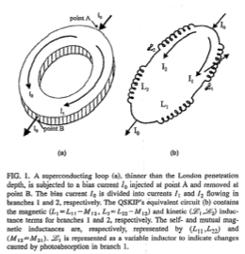
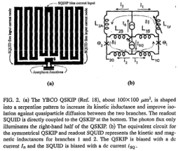

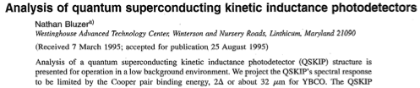
Bluzer 1995 kinetic inductance detector, T<<T_{c}
Sergeev & Reizer 1996; + Sergeev, Mitin & Karasik 2002

Slide 8
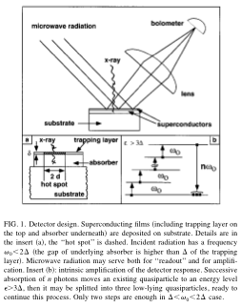

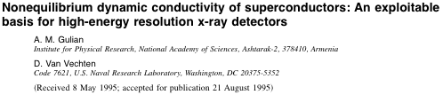
1995: Microwave dissipation readout
Quasiparticle generation by microwaves

Slide 9
Cheap Physics Tricks
Make differential measurements
  See McDonald, 1987
Use resonant circuits
  SIS mixer tuning circuits, Schoelkopf’s RF-SET
Assume that it’s spherical
  (but we’re not theorists…)

Slide 10
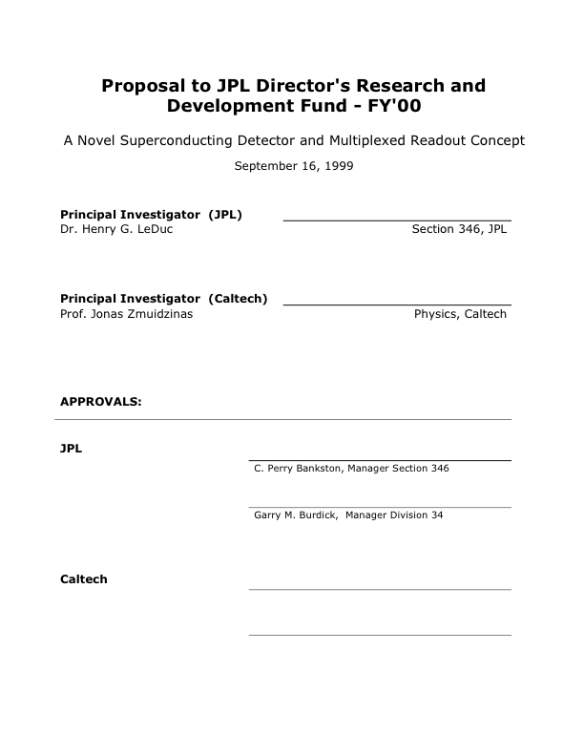
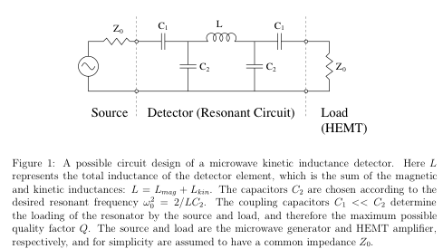

1999: First MKID proposal
- internal Q
- coupling Q
- resonator Q

Slide 11
Issues considered in proposal
Responsivity (Mattis-Bardeen, expected Q)
Intrinsic detector noise
  Random generation & recombination of quasiparticles
Microwave amplifier noise
Limitation on maximum microwave power
  Absorbed microwave power < optical power
Phase noise of readout system
Expected NEP (below 10⁻¹⁸ W Hz^{-1/2})
Multiplexing:
  “Digital techniques are especially attractive since in principle multiple frequency components could be generated or analyzed simultaneously. However, the efficacy of digital techniques will depend on the frequency spacing (detector Q) and the available clock rates”

Slide 12
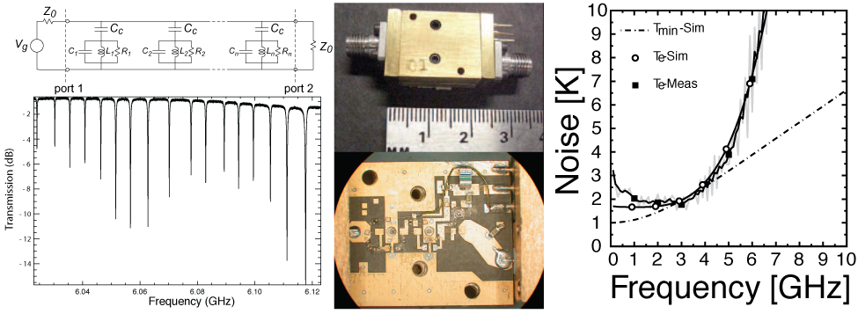
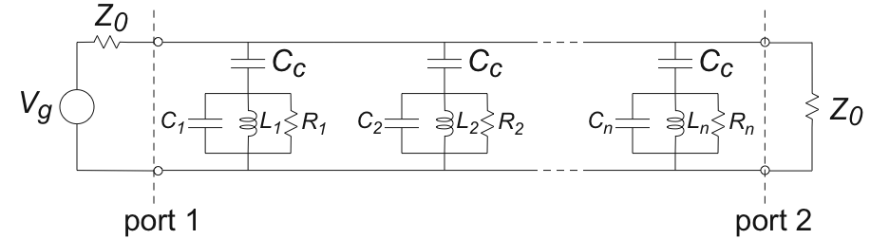
Multiplexing
SiGe cyrogenic bipolar amp: Joe Bardin and Sandy Weinreb (Caltech)

Slide 13



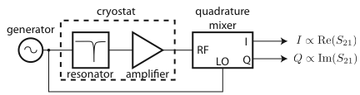

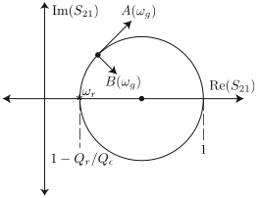
Resonator Readout
Vector measurement of S₂₁ provides information on both frequency (σ₂) and dissipation (σ₁)

Slide 14







Conductivity Perturbations
Start at T=0 and turn on thermal, optical, and microwave excitation:
Then analyze effect of small perturbations
Surface impedance for a thin film:

Slide 15
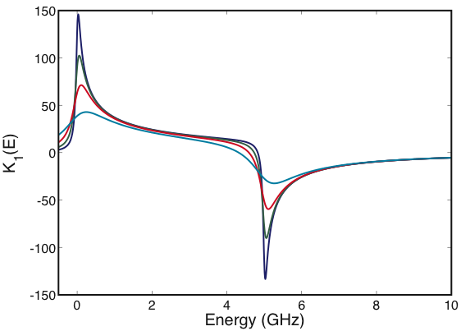
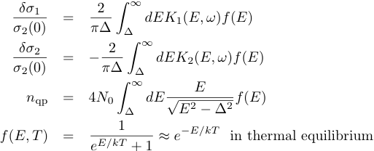
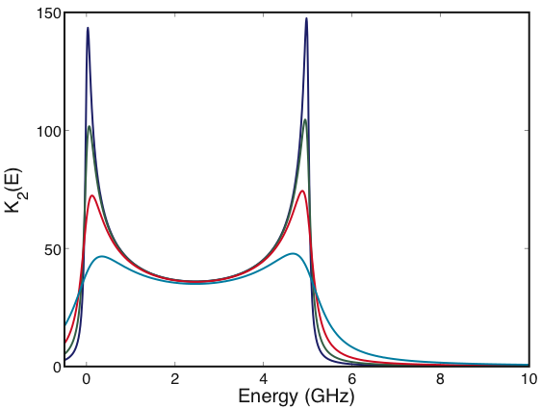
Response to Quasiparticles
K₁ = dissipation kernel
K₂ = “inductance” kernel
K₂
5 GHz readout
90 GHz gap
K₁
5 GHz readout
Energy broadening
also reduces response
Insensitive to quasiparticles with E > hν
Reduced response for hot quasiparticle population

Slide 16

Quasiparticle Distribution Function
Owen-Scalapino model:
  OK if recombination time much longer than cooling time
But experiments* using microwave pulses reveal:
  Absorbed microwave power produces quasiparticles
  Microwave power heats the quasiparticle distribution
It is important to understand these effects since they limit maximum readout power that can be used
  Amplifier noise contribution, TLS noise, dissipation signal (σ₁)
Need to go beyond Owen-Scalapino
*A. Vayonakis PhD Thesis, Caltech, 2010

Slide 17
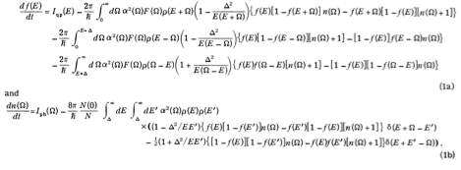

Calculating f(E)*
Quasiparticle injection
Phonon absorption
Phonon emission
The population of states with energy E changes because:
Recombination
Pair breaking
Phonon equation
*A. Vayonakis PhD Thesis, Caltech, 2010
Notes:
Important to understand this: quasiparticle creation by microwaves controls optimum readout power

Slide 18
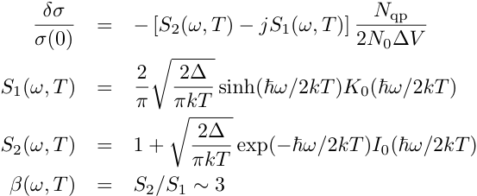
A (too?) simple model
Ignore microwave heating of quasiparticles
  Follow Owen-Scalapino:
  Reduce problem to one variable:

Slide 19
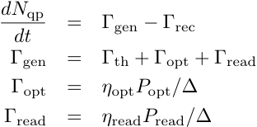
Quasiparticle Generation
Allow microwave generation of quasiparticles:
(should add g-r noise term)

Slide 20
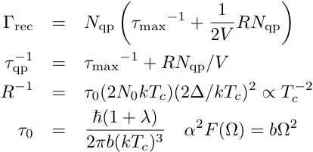
Quasiparticle Recombination
See Kaplan et al, PRB 14, 4854, 1977

Slide 21
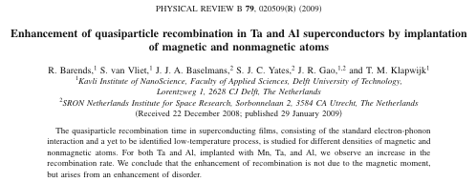
Quasiparticle Recombination

Slide 22
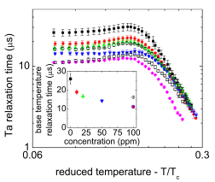
Quasiparticle Recombination

Slide 23
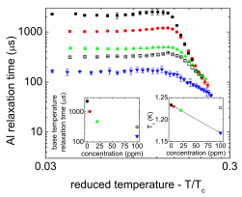
Quasiparticle Recombination

Slide 24
Quasiparticle Recombination
Observation: for a wide range of materials,
Describes gross trends (Nb → Ta → Al)
But n* seems also to vary somewhat (with disorder, purity, …)
Nonmagnetic quasiparticle traps in bulk ?
Magnetic effects at surface ? (Barends et al 2009)
N.B. A quasiparticle that becomes trapped causes a change in the conductivity; don’t need to wait for recombination with another quasiparticle

Slide 25



Calculating MKID Responsivity
Set generation = recombination
  Calculate N_{qp}(T, P_{opt}, P_{read})
Analyze small perturbations
  Could include frequency roll-off due to resonator bandwidth & quasiparticle lifetime, nonzero generator-resonator detuning, microwave power feedback, etc.
  Keep it simple here:

Slide 26
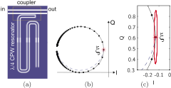
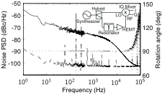
Noise: Gao et al. 2007
(APL 90, 102507)

Slide 27
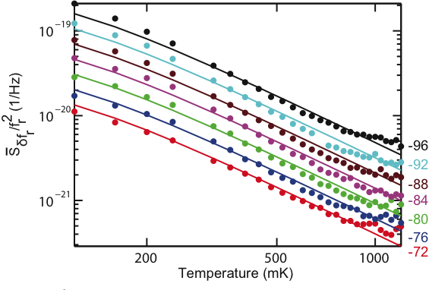
Noise: Kumar et al. 2008
(APL 92, 123503)

Slide 28
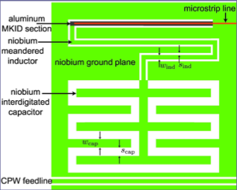
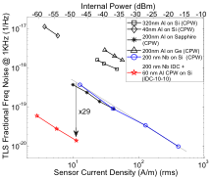
Surface TLS noise reduction with IDC
Noroozian et al. LTD 2009 (AIP Conf. Series vol. 1185)
Demonstrates that noise source is “capacitive” rather than “inductive”
Consistent with surface distribution of TLS fluctuators (Gao et al 2008 a,b)
Conclusion: develop better (TLS-free) capacitors !

Slide 29

Dissipation Readout
No TLS noise for dissipation readout
  Baselmans et al. approach for NEP < 10⁻¹⁸ W Hz^{-1/2}
Amplifier noise NEP:
Achieved when:
Compare to photon NEP:
  T_{amp} ~ 2 K should reach BLIP in submm/far-IR
  Achievable with SiGe bipolar amps (Bardin/Weinreb)

Slide 30
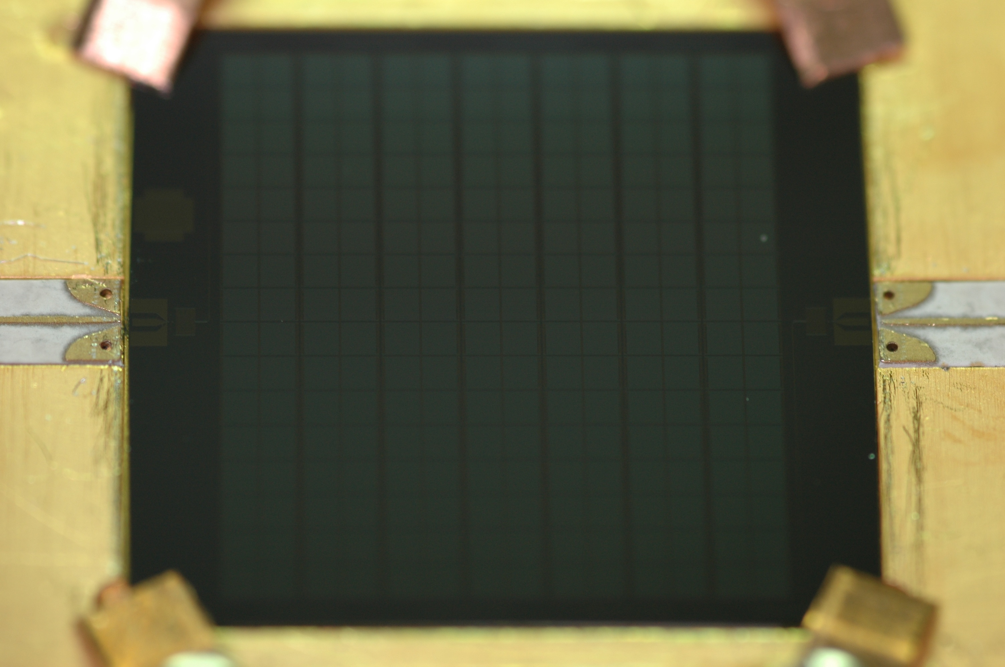
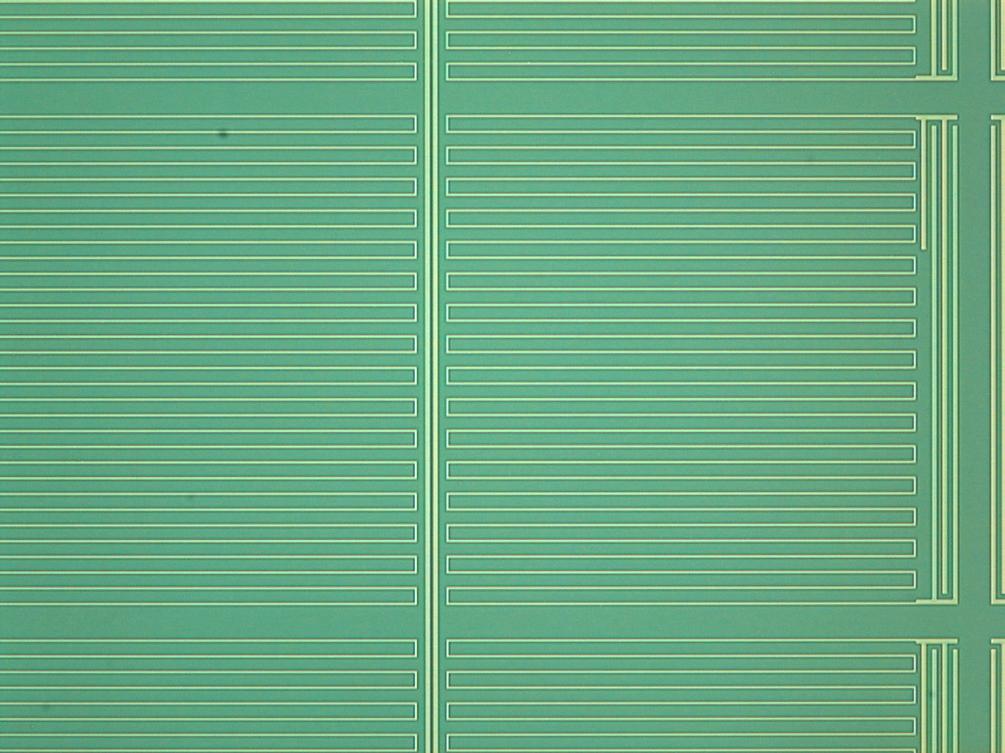
Far-IR TiN MKID Array

Slide 31
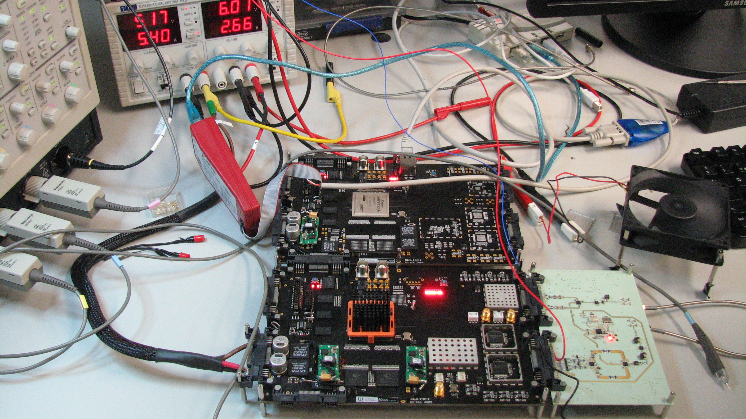
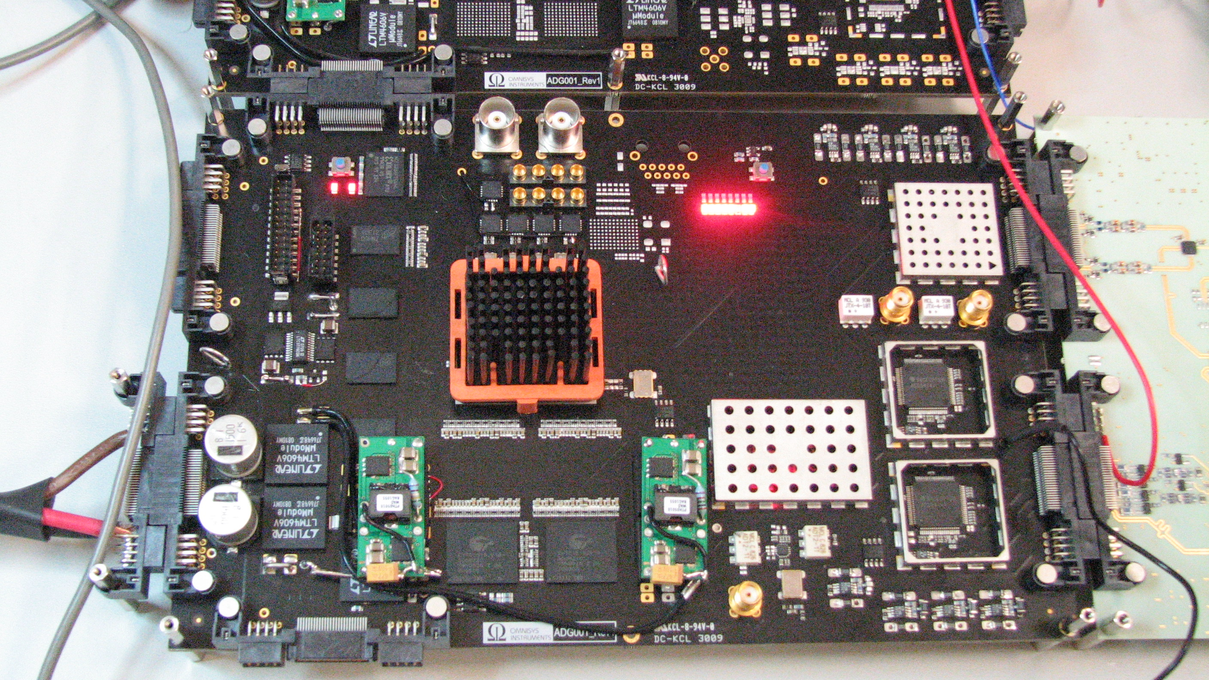
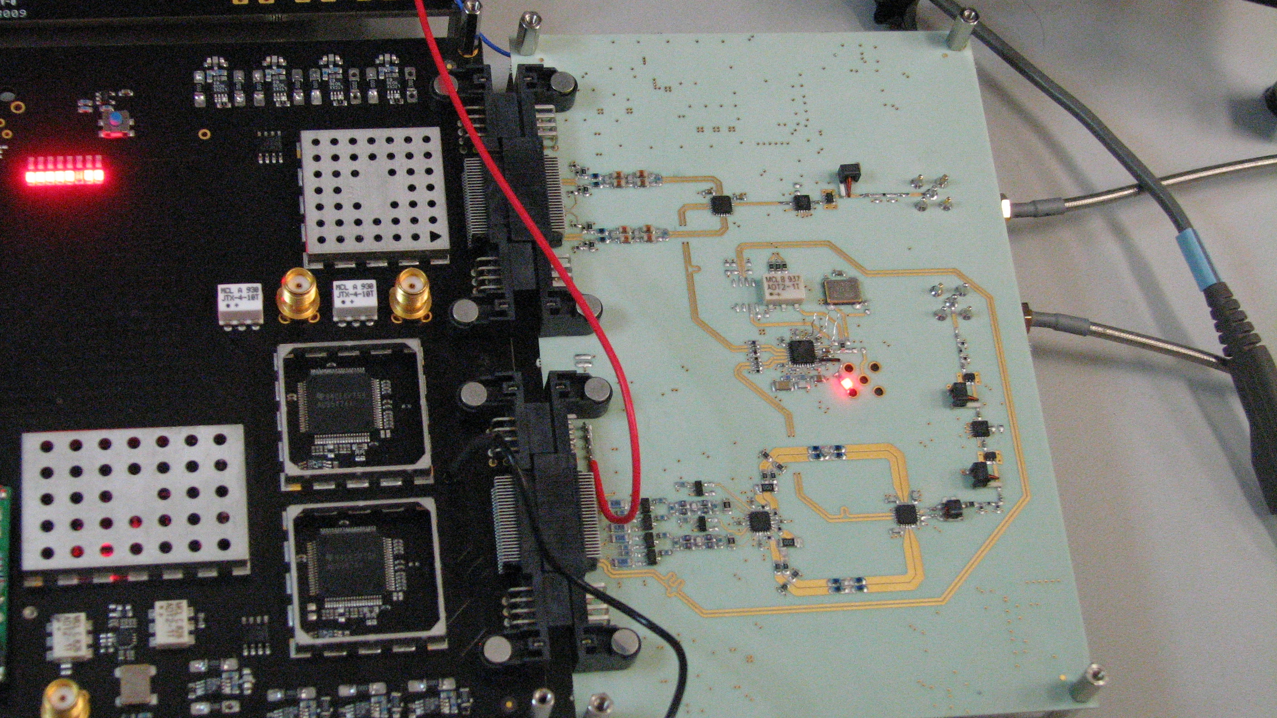
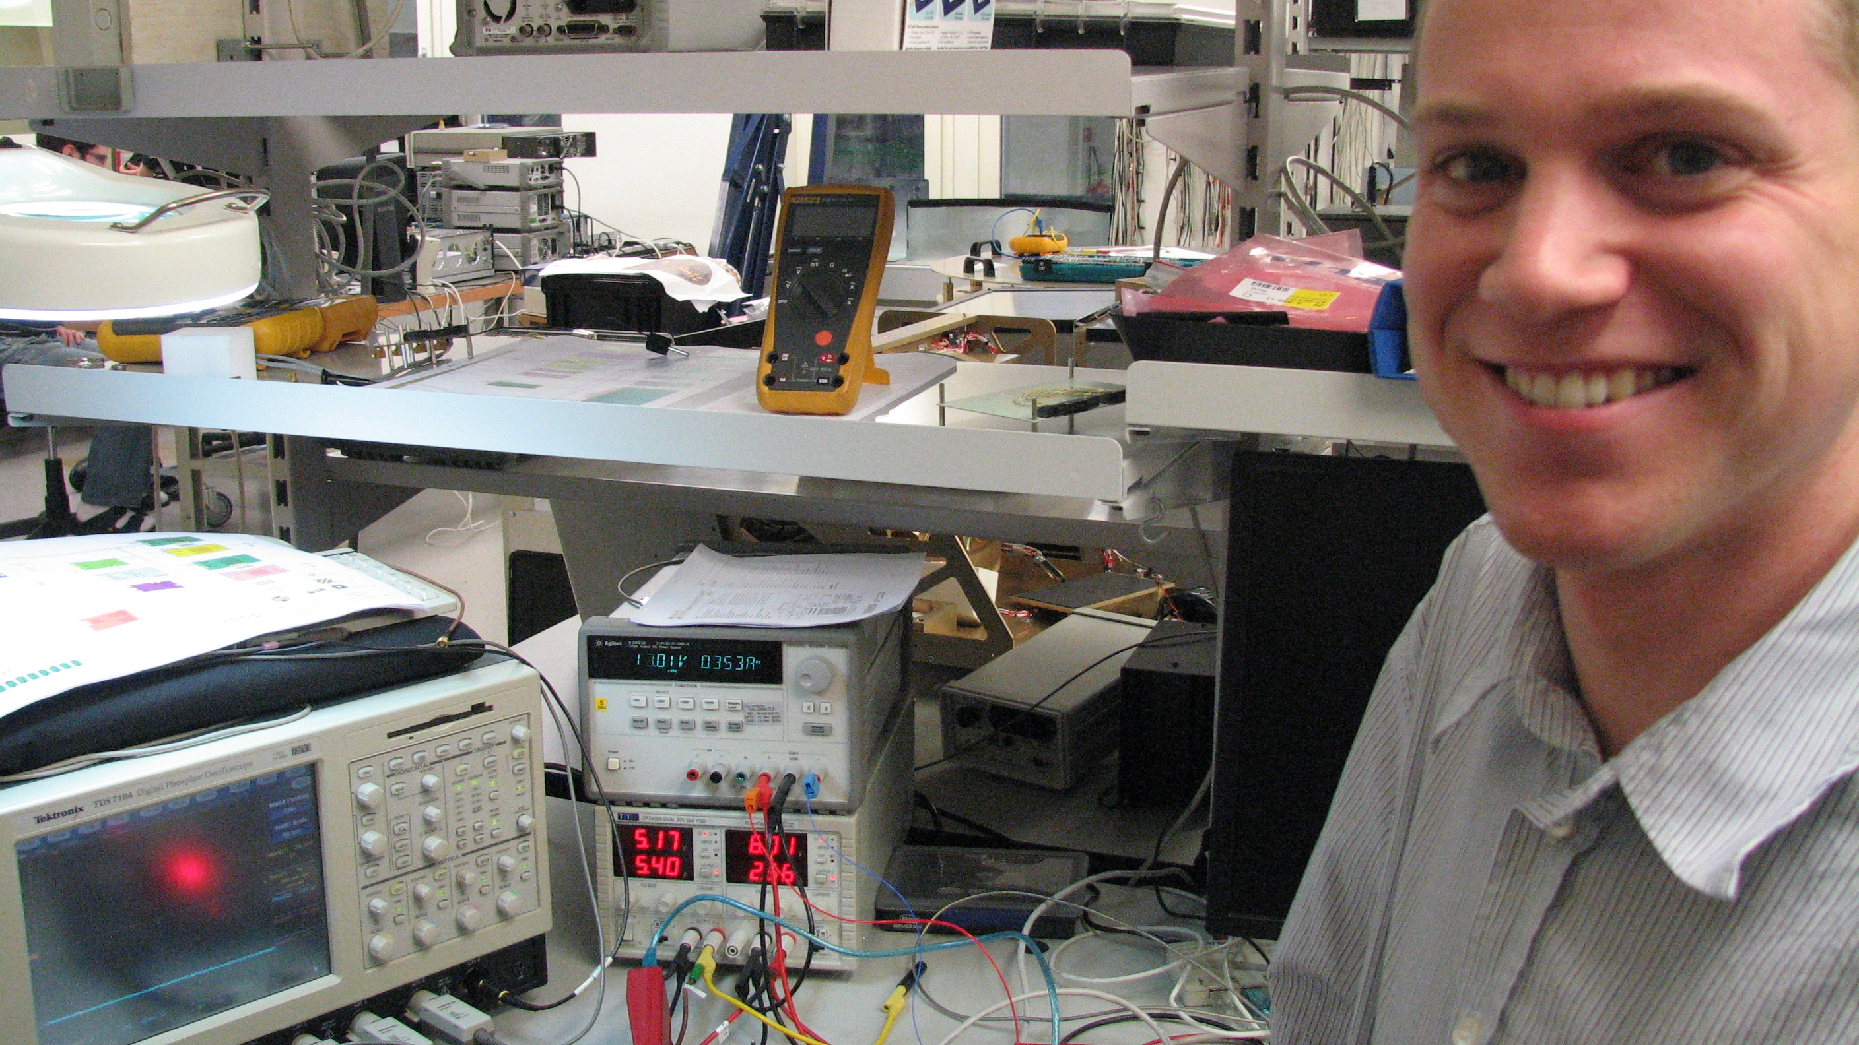
MUSIC readout at Omnisys AB
Johan Riesbeck, Martin Kores, Anders Emrich

Slide 32
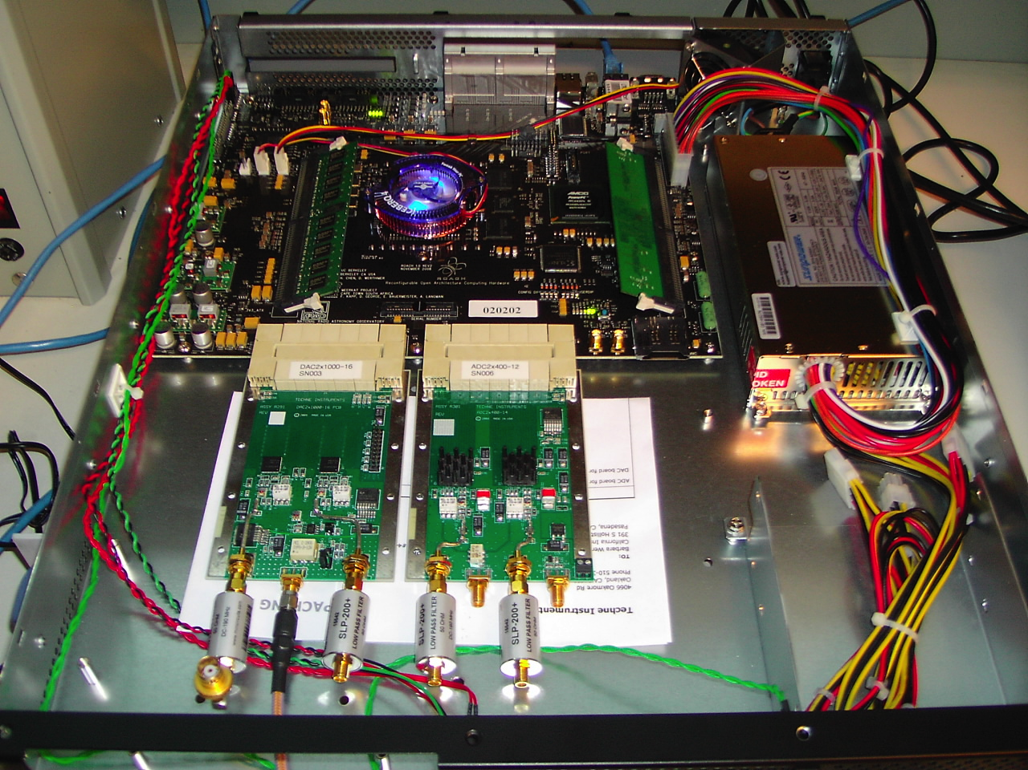
UCSB/Berkeley OSR Consortium

Slide 33

Future Prospects
Good progress in our fundamental understanding
  Key issues remain, e.g. quasiparticle recombination, effect of microwaves
Major progress toward system demonstrations
  Readout electronics rapidly approaching reality
New materials offer very exciting prospects
  Combination of high resistivity and very high Q
  NEP below 10⁻¹⁹ W Hz^{-1/2} now looks quite feasible

Slide 34
Future Prospects
Far-IR absorber-coupled pixels
  Cardiff Lekid design looks very simple & attractive
  GSFC has alternate concept
  Pixel-pixel microwave coupling is a critical issue, but appears to be solvable
Prediction:
  1D and 2D MKID submm/far-IR arrays are going to be available in the relatively near future !

