Slide 1
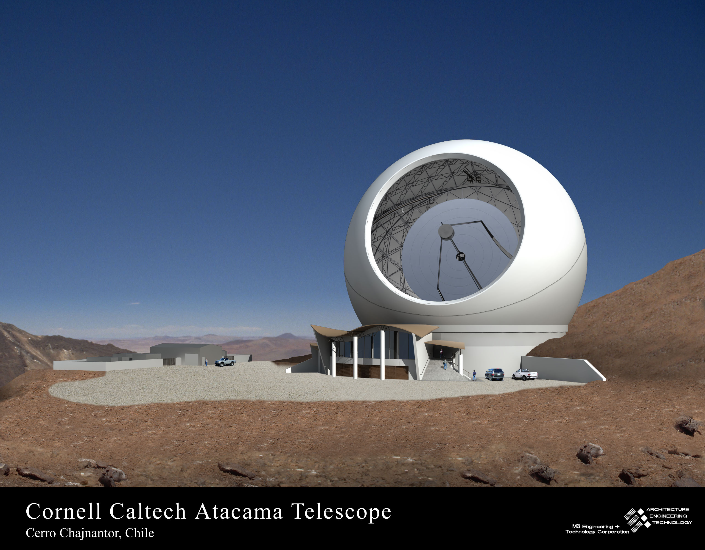
Surveying the Submillimeter Universe with CCAT
25m dia, 10μm rms
20’ FOV → 1º FOV
0.5” rms pointing
1deg/s scan speed
Cameras:
λ=0.74-2mm
λ=0.2-0.62mm
MOS
Total cost $120M
Jonas Zmuidzinas
Caltech
Cornell, Caltech/JPL, CU Boulder, AUI, UK ATC, BC & Waterloo, Köln & Bonn

Slide 2
Brief History
Pre-2003
  Cornell investigates IR telescope in Atacama
  Caltech operating CSO on Mauna Kea
2003: initial discussions
  Bradford & Zmuidzinas 2003 (paper in Proc. 4th Zermatt symposium)
  Cornell/Caltech meeting
2004: MOU, study funding, PM Tom Sebring and DPM Simon Radford hired
2005: Feasibility study
2006: Review of Feasibility Report
  Cost: $100M
  Additional partners needed
2007 – present
  Partnership development: Colorado, UK, Canada, Koln/Bonn
  Technical studies (achieving 10 μm surface)
  Ongoing detector & instrumentation development
2009
  Astro2010 review
  Steve Padin (SPT/Chicago) joins Caltech to lead telescope design

Slide 3
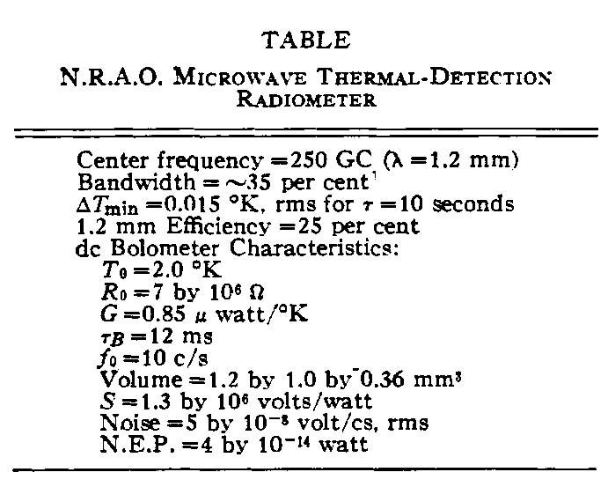
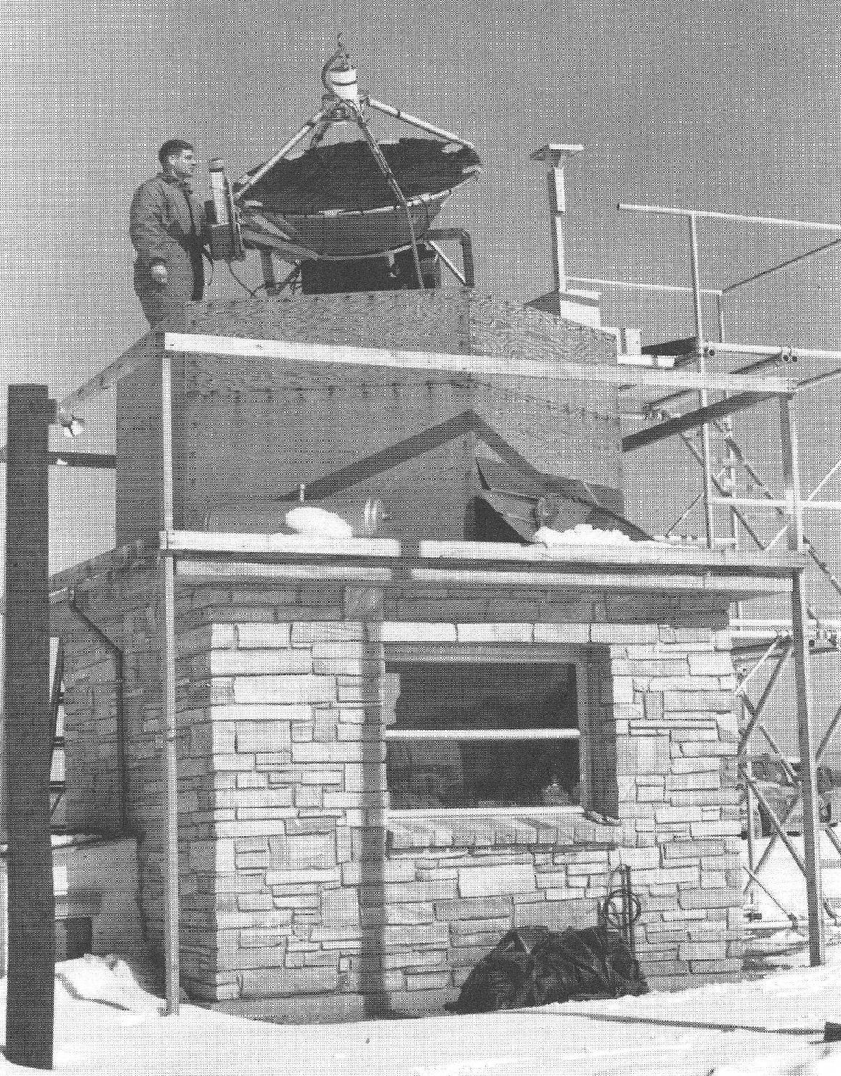
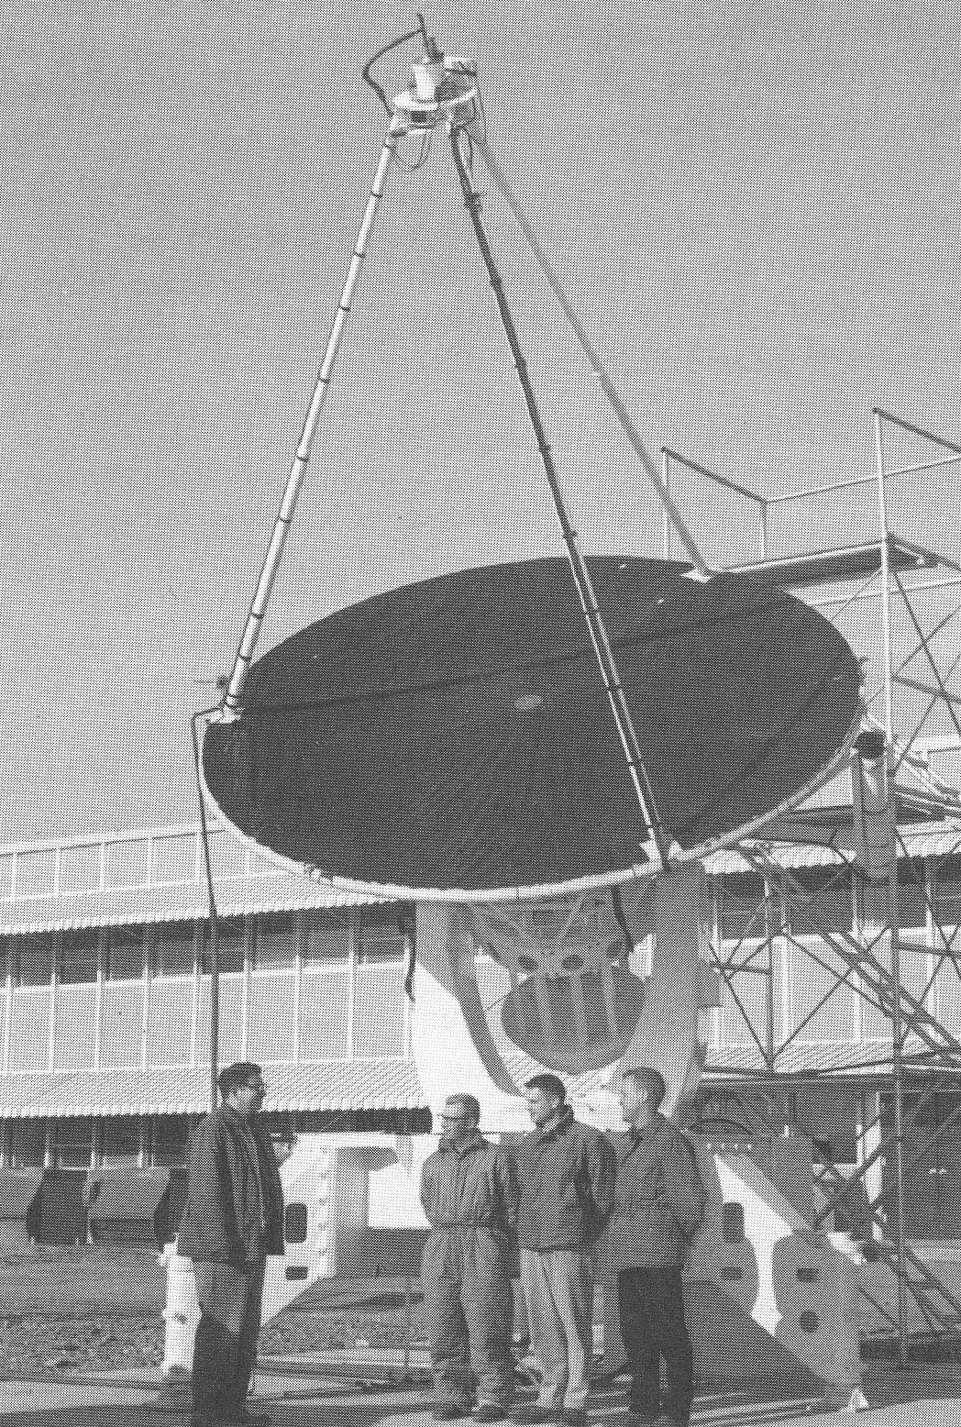
Early mm-wave astronomy
1961: Frank Low invents the Ge bolometer
1963: Sun, Moon, bright planets
Sub/mm mapping speed:
Doubling time = 1.5 years
(over the past 45 years)
NRAO 5-foot mm-wave telescope
NRAO 12-foot mm-wave telescope

Slide 4
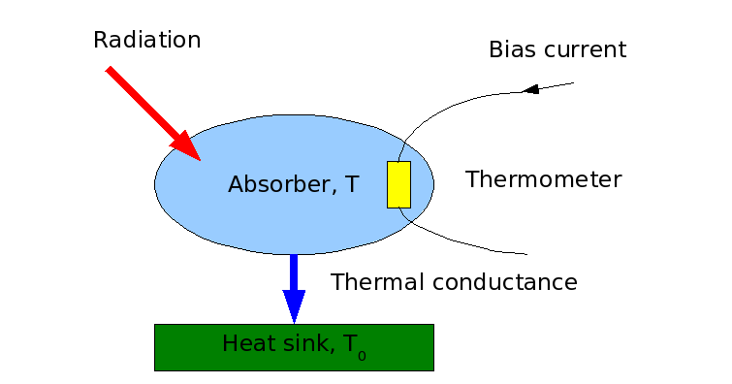
Bolometers
(S. Langley, 1878)
1878: invented by Langley

Slide 5
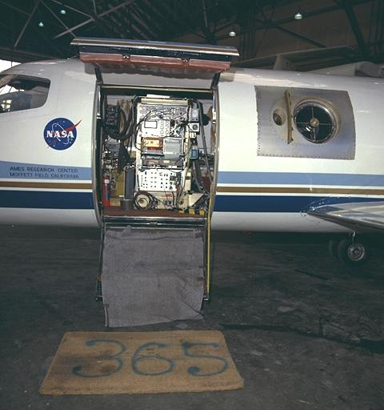
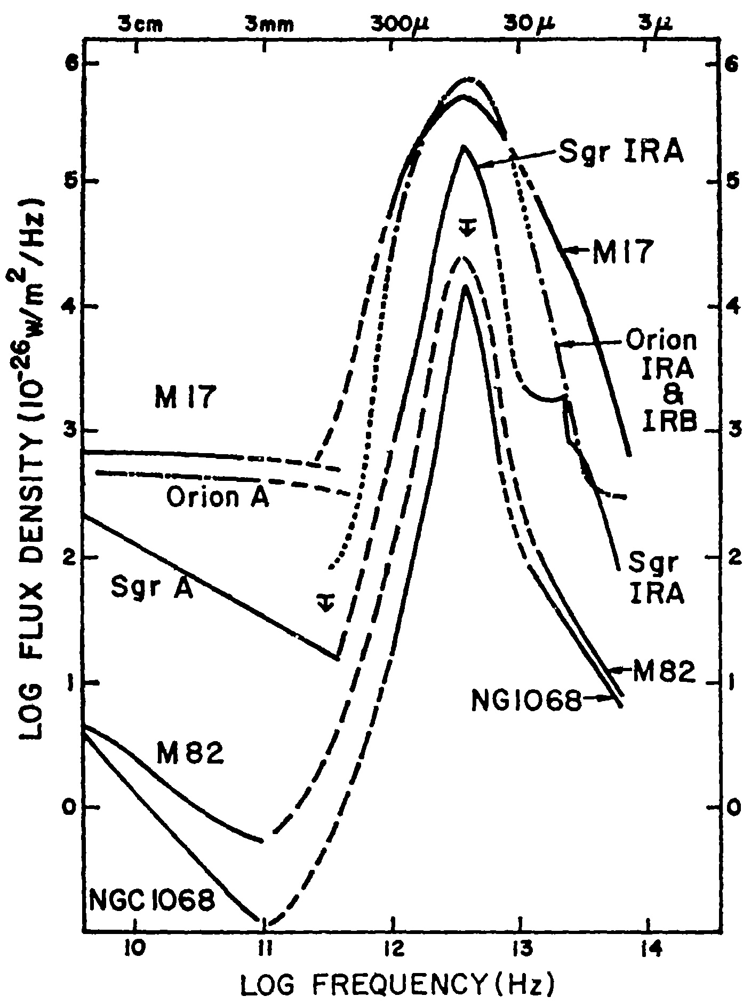
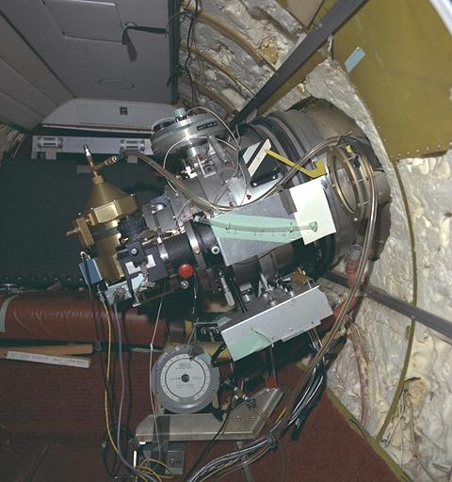
Airborne astronomy, 1970
Low & Aumann, ApJ 162
Lear Jet Observatory

Slide 6
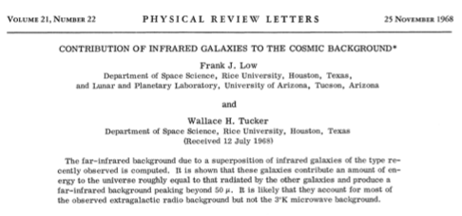
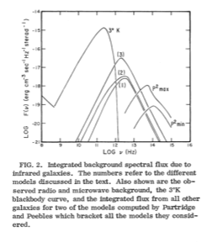
Low & Tucker, 1968

Slide 7
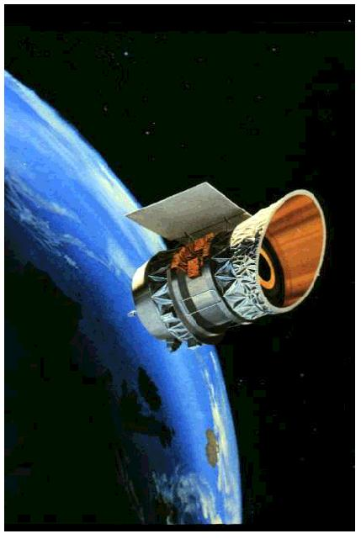
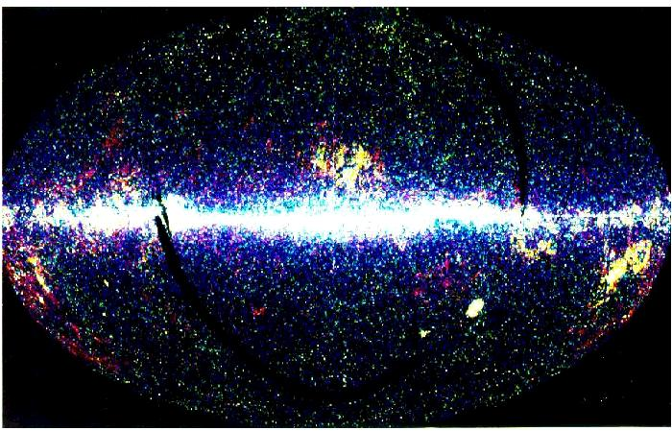
1983: IRAS finds ULIRGS
NASA/JPL/Caltech/IPAC

Slide 8
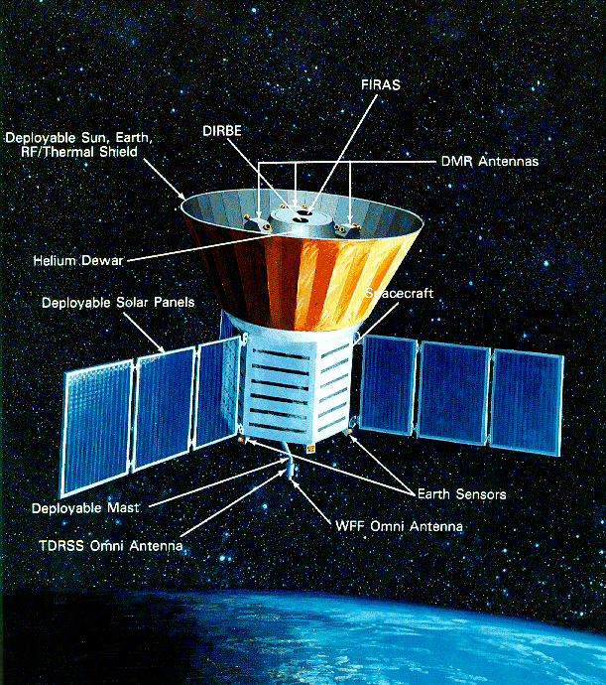
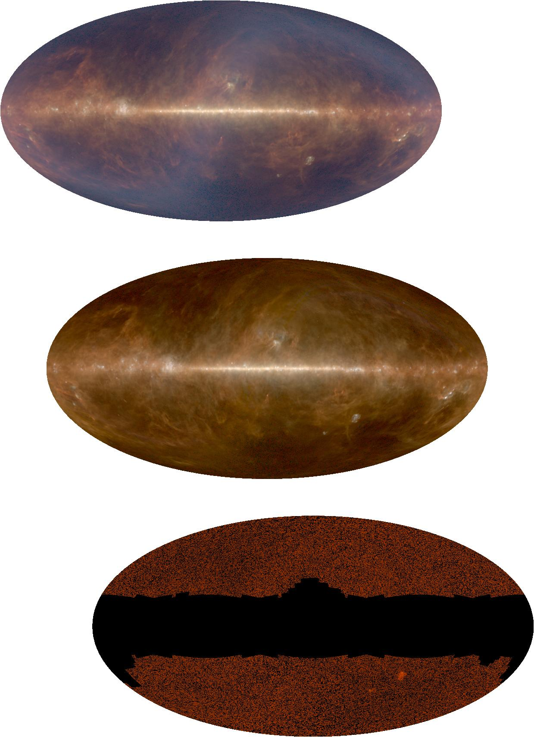
1996: COBE Discovers Cosmic Infrared Background
Puget et al 1996; Hauser & Dwek 1998
2006 Nobel: CMB anisotropy, spectrum

Slide 9
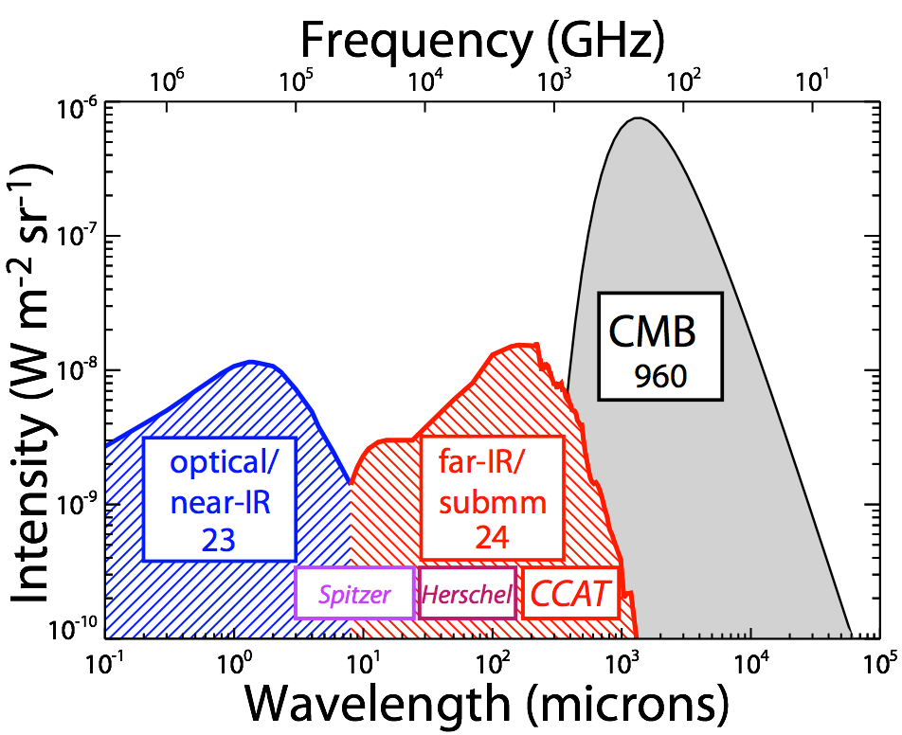
Light in the universe
Dole et al. 2006

Slide 10
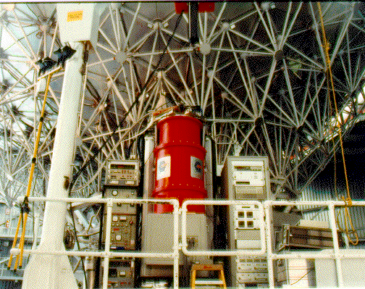
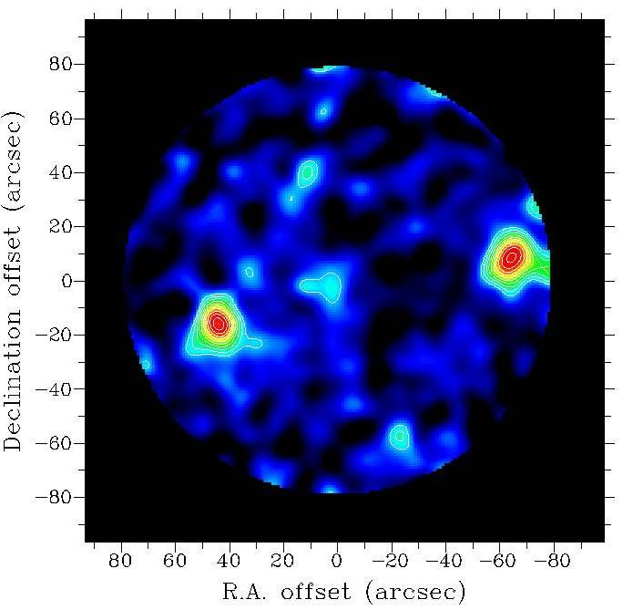
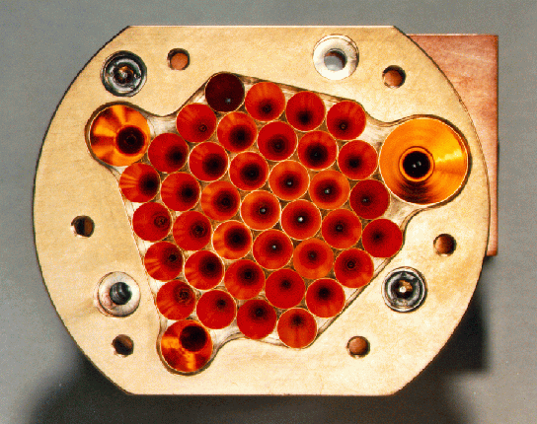
SCUBA, 1997
Smail, Ivison & Blain ApJ 490, L5

Slide 11
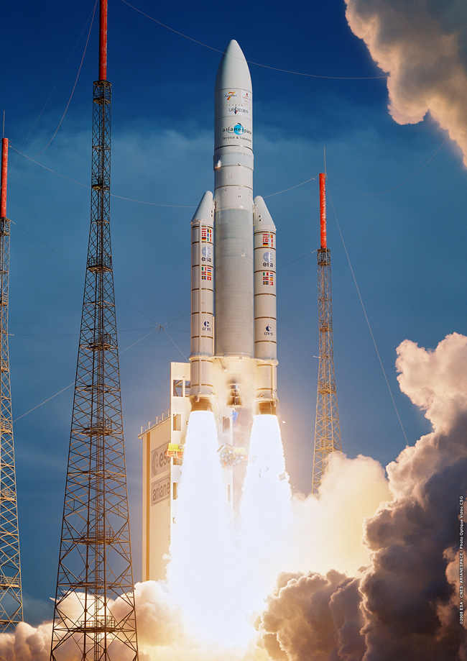
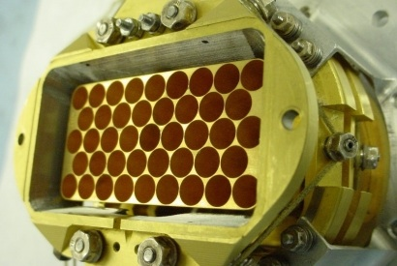
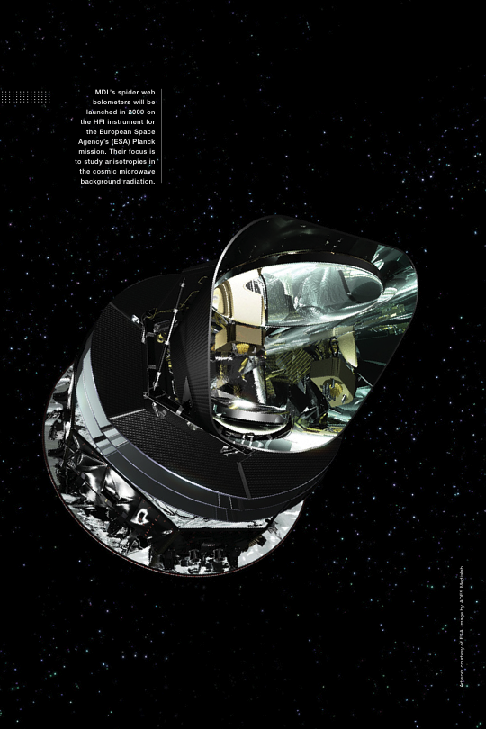
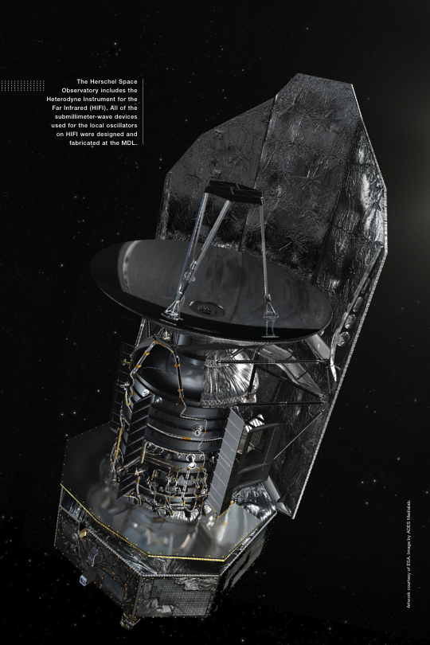
Herschel & Planck
May 6, 2009
CIT/JPL detectors for HSO/SPIRE

Slide 12
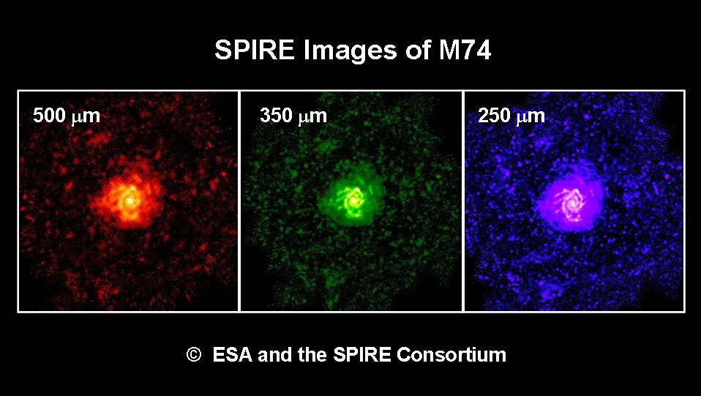
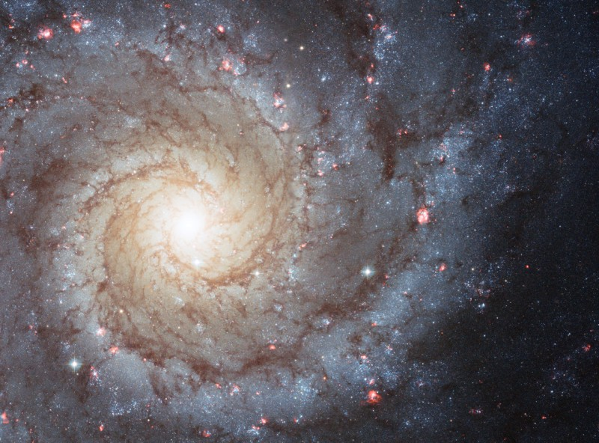
Submm Galaxies Near and Far

Slide 13
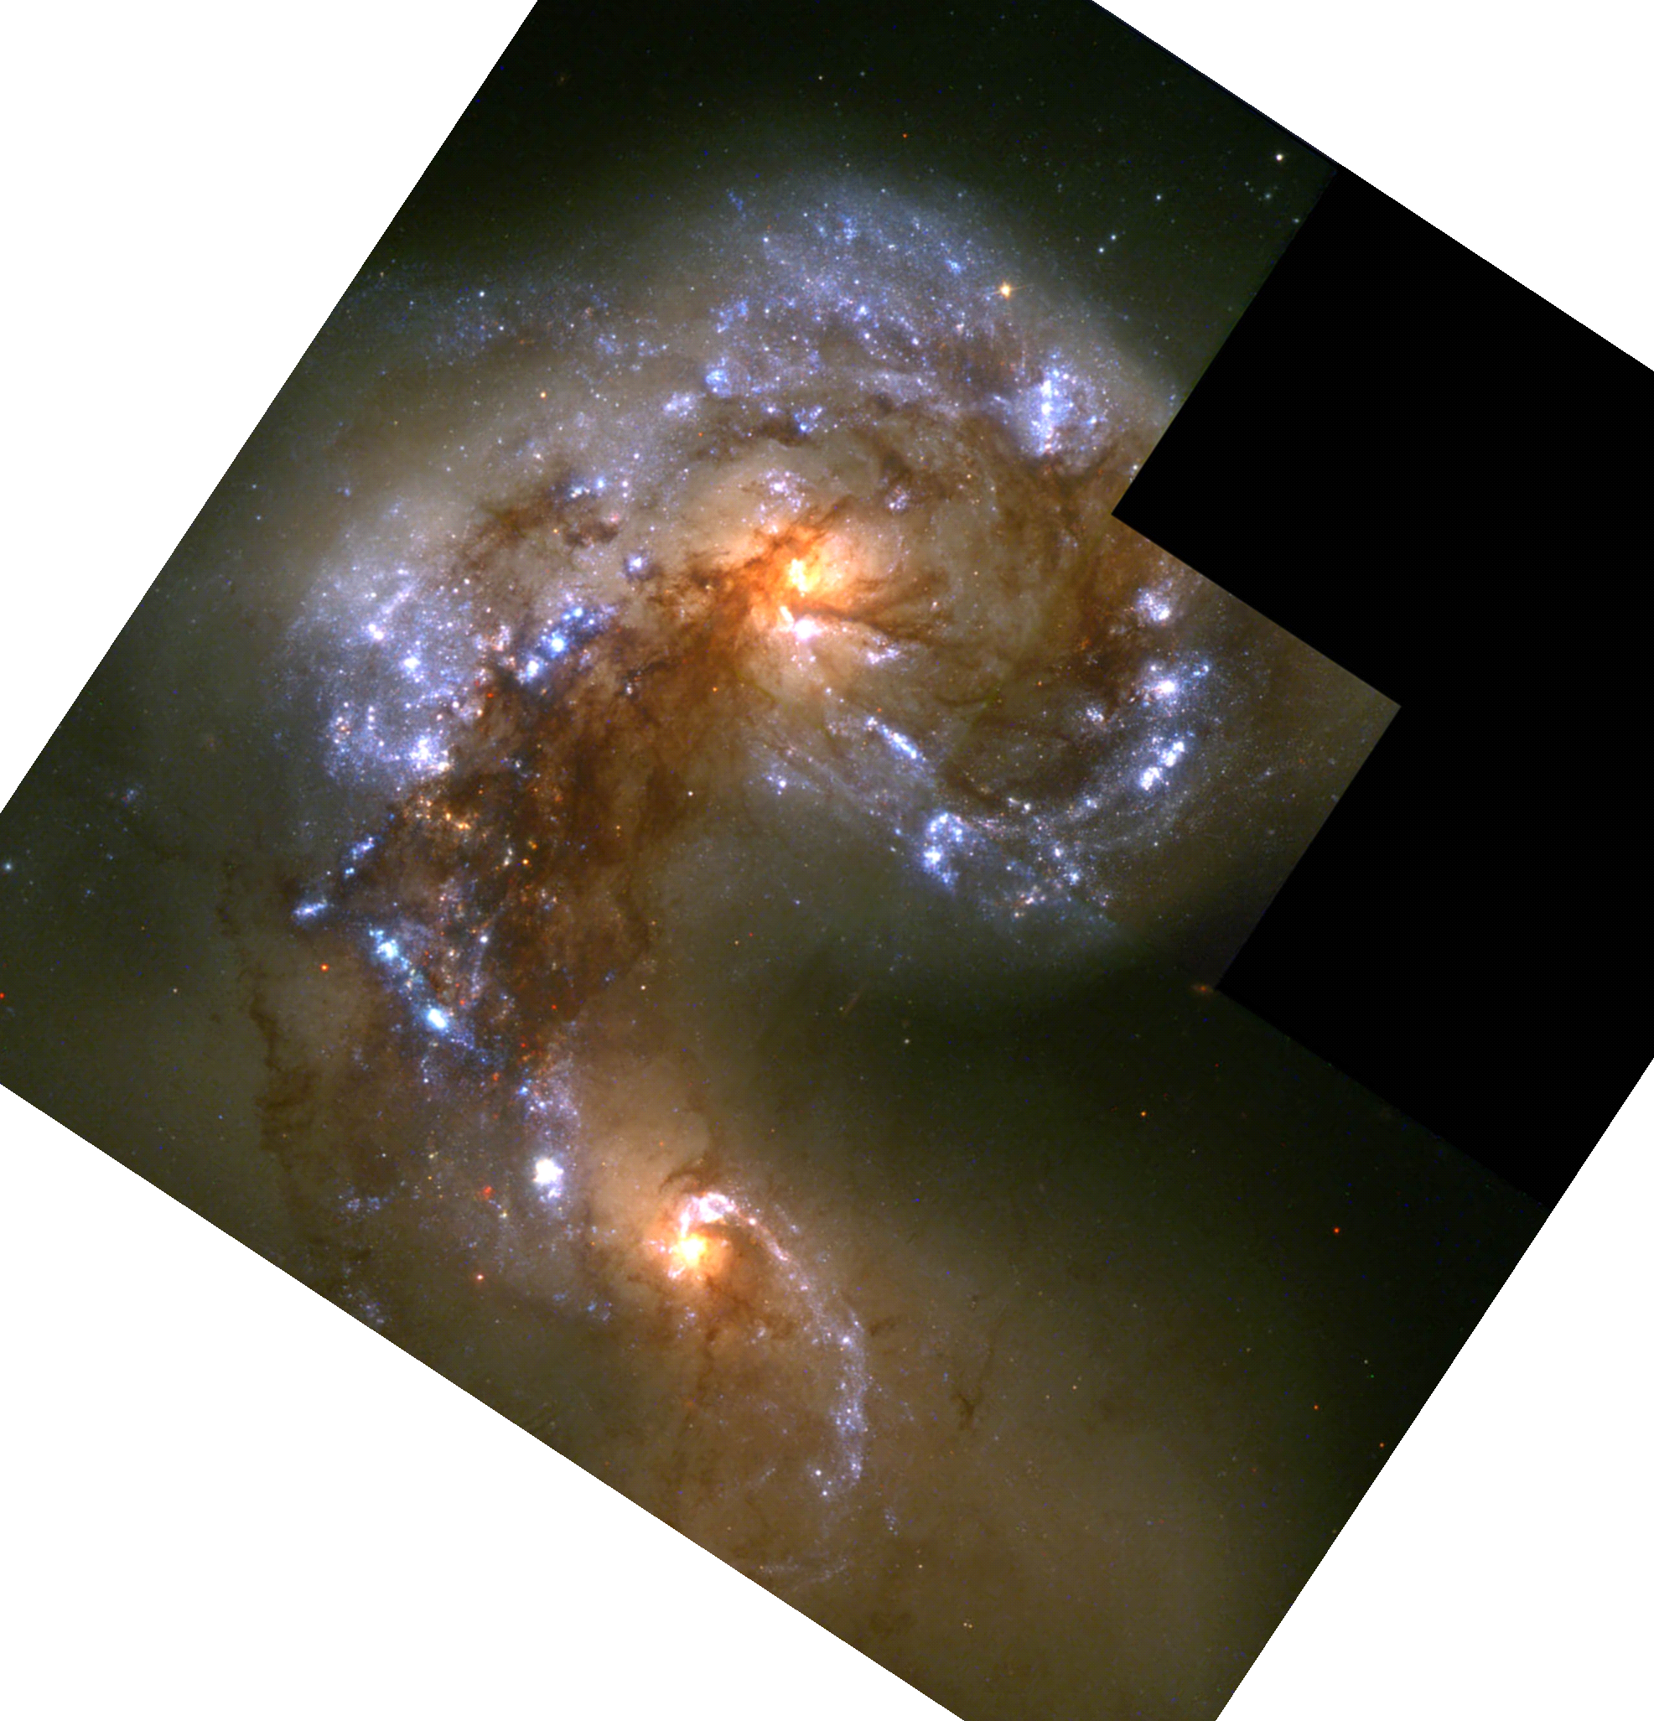
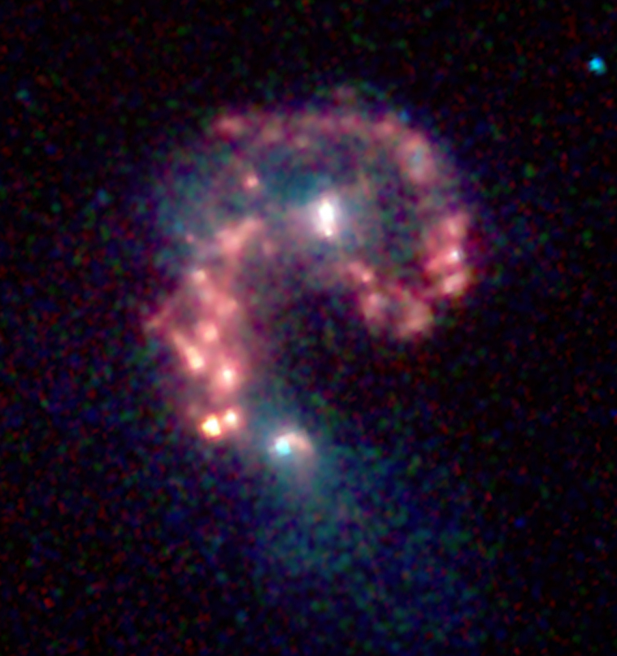
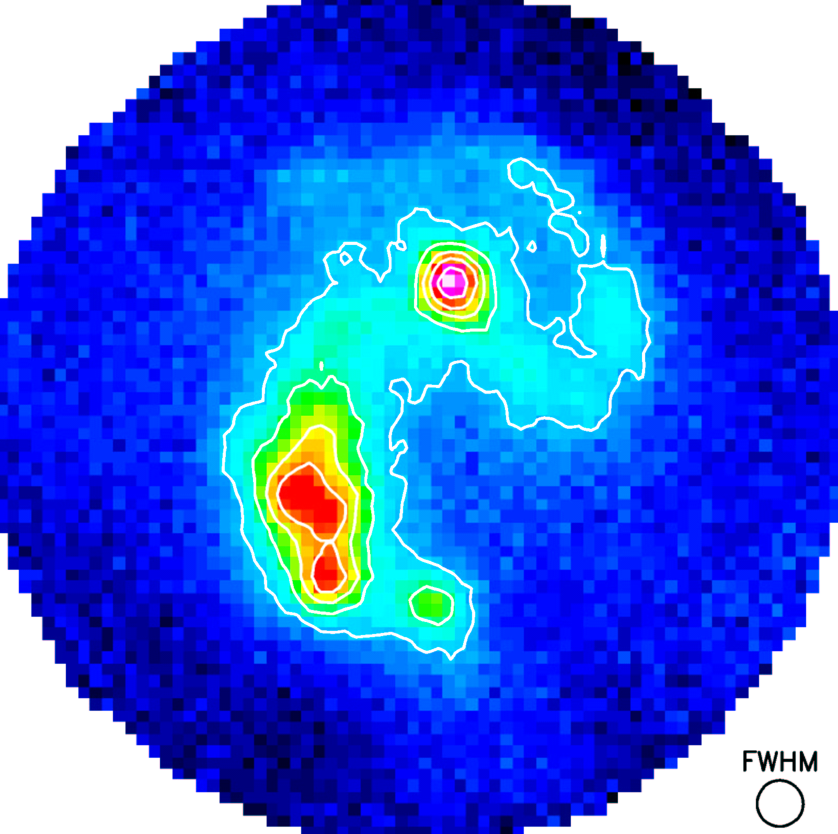
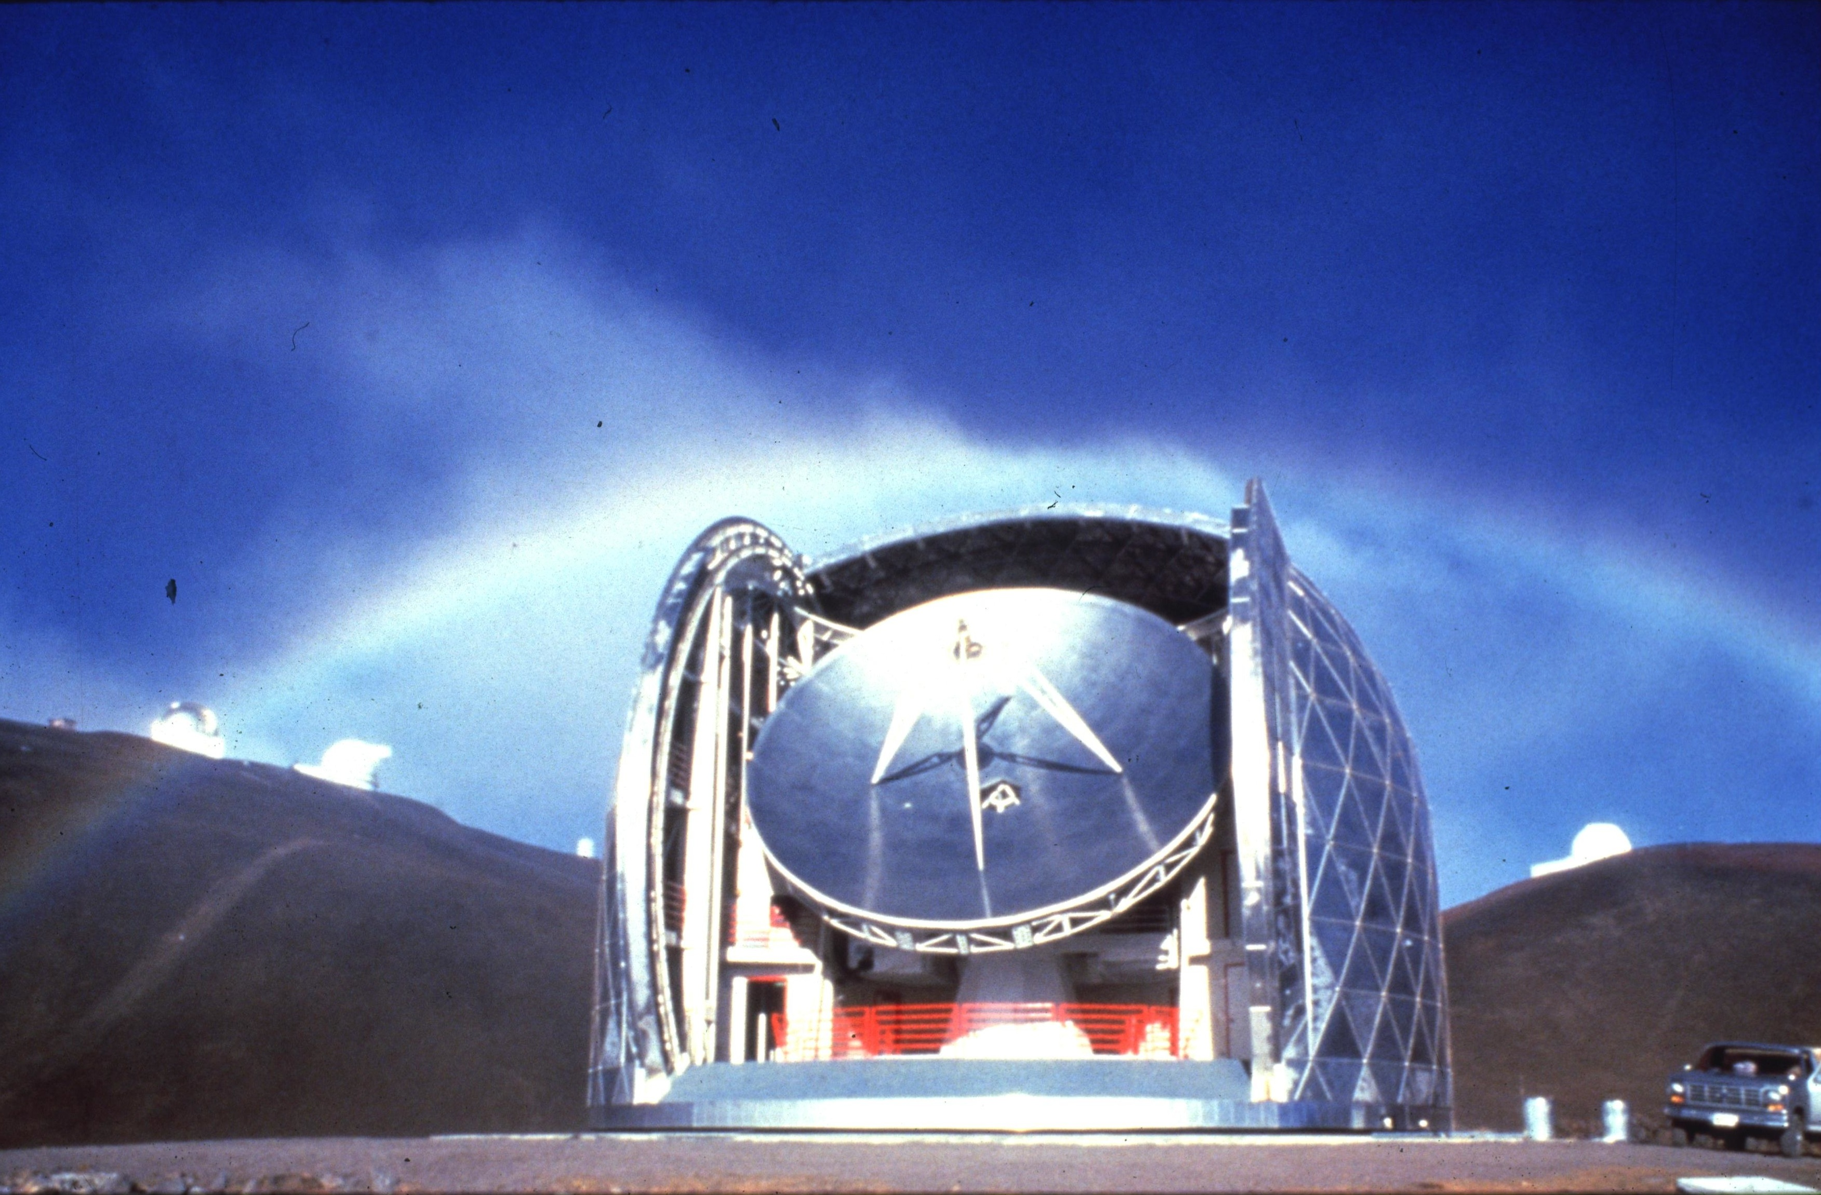
A nearby galaxy merger
NGC 4038/4039 – the “antennae”
visible
infrared
submm
Visible
Infrared
Sub-mm
CSO
IRAS
IRAS all sky map

Slide 14
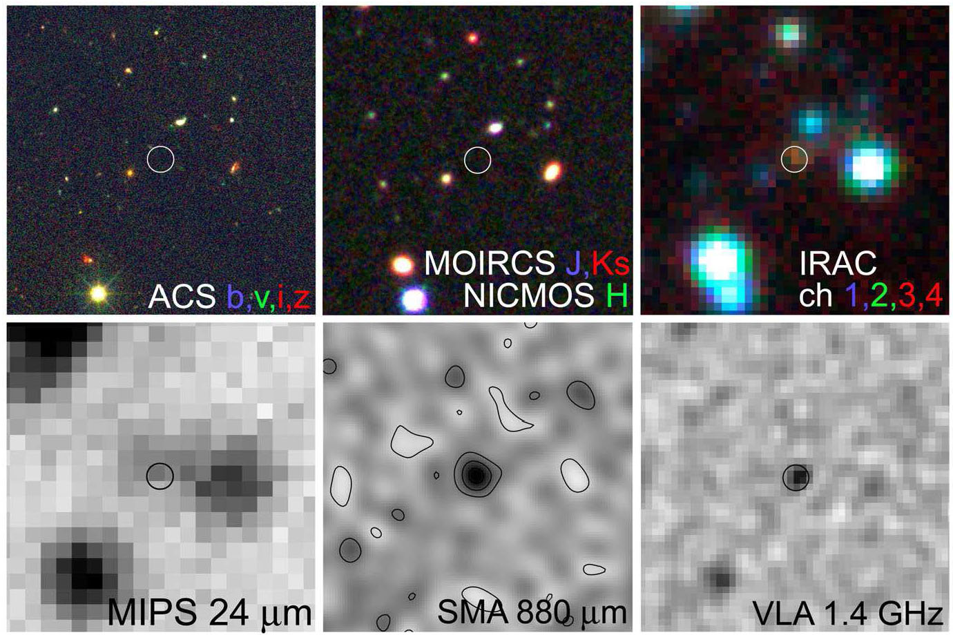
GOODS 850-5: SMG at z = 4
visible
near-IR
mid-IR
far-IR
submm
radio
Wang, Barger & Cowie 2009, ApJ 690, 319; Daddi et al. 2009, ApJ 695, L176

Slide 15
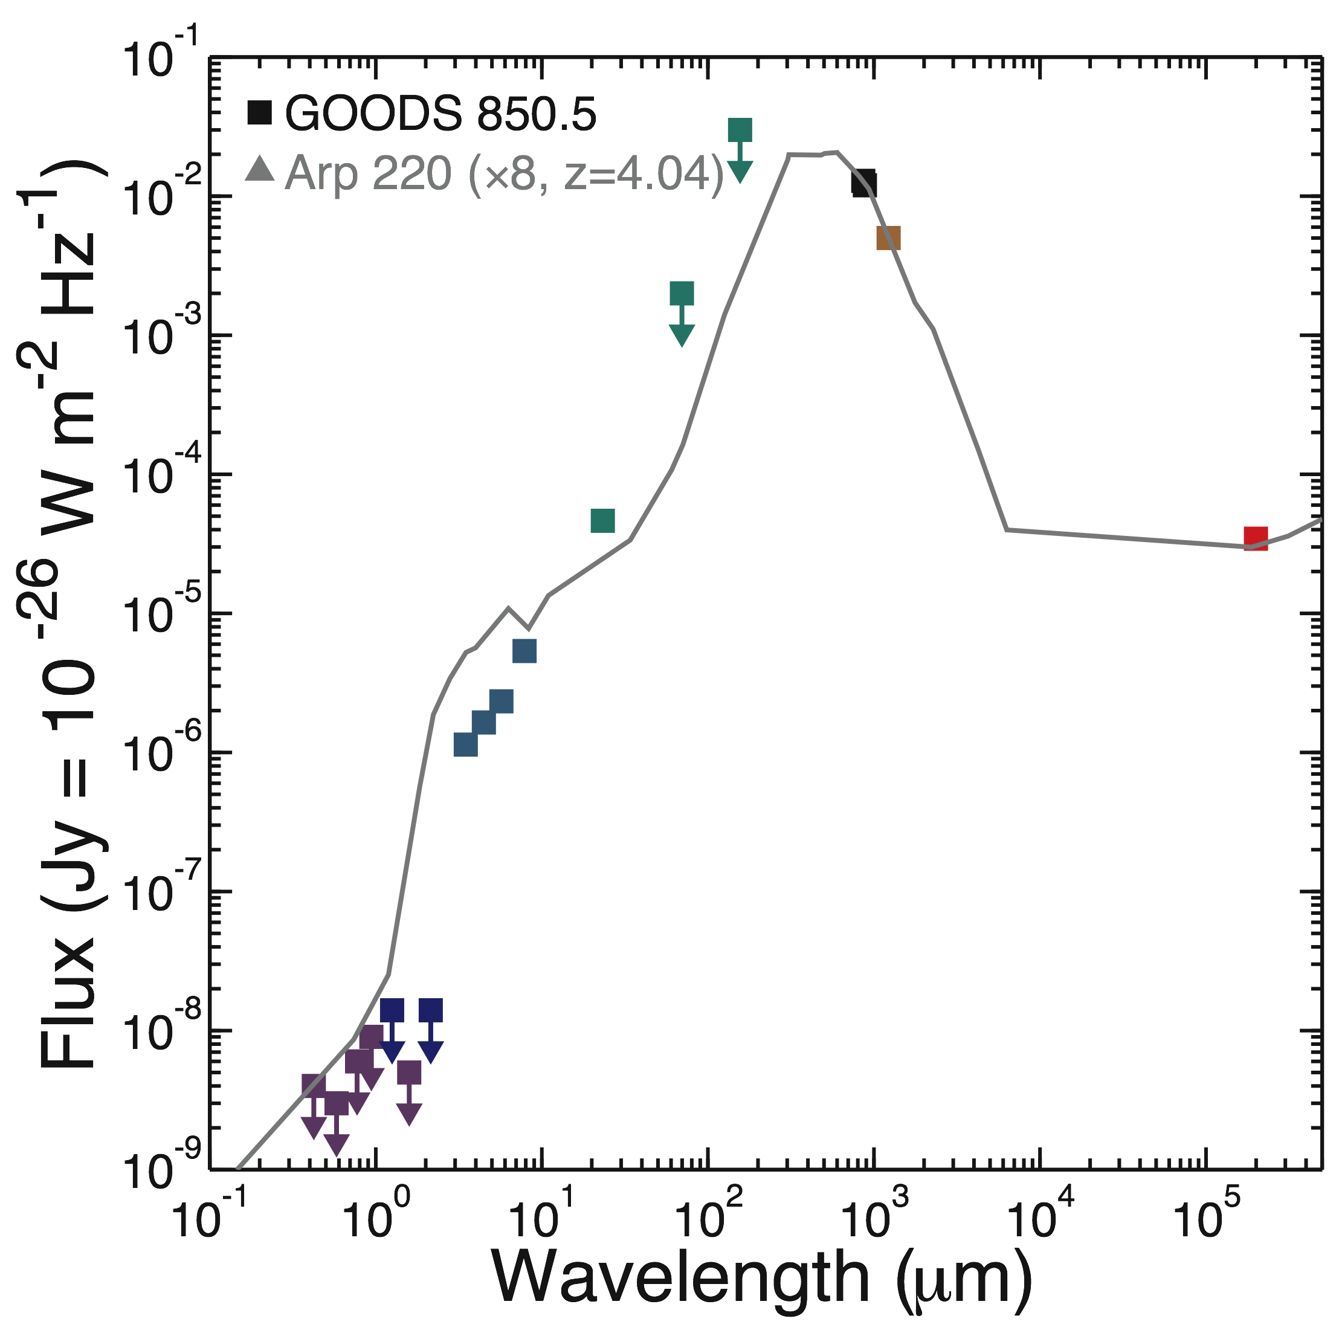
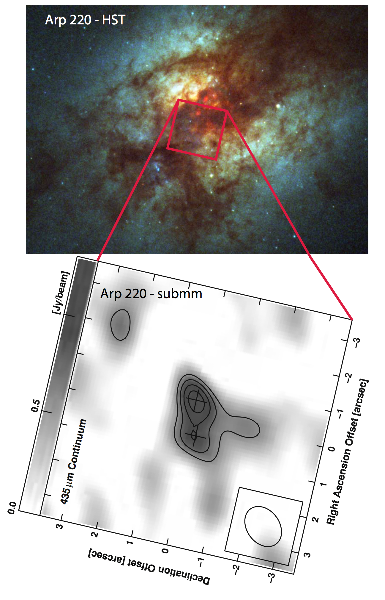
GOODS 850-5 (z = 4) vs. Arp 220 (z = 0.018)

Slide 16
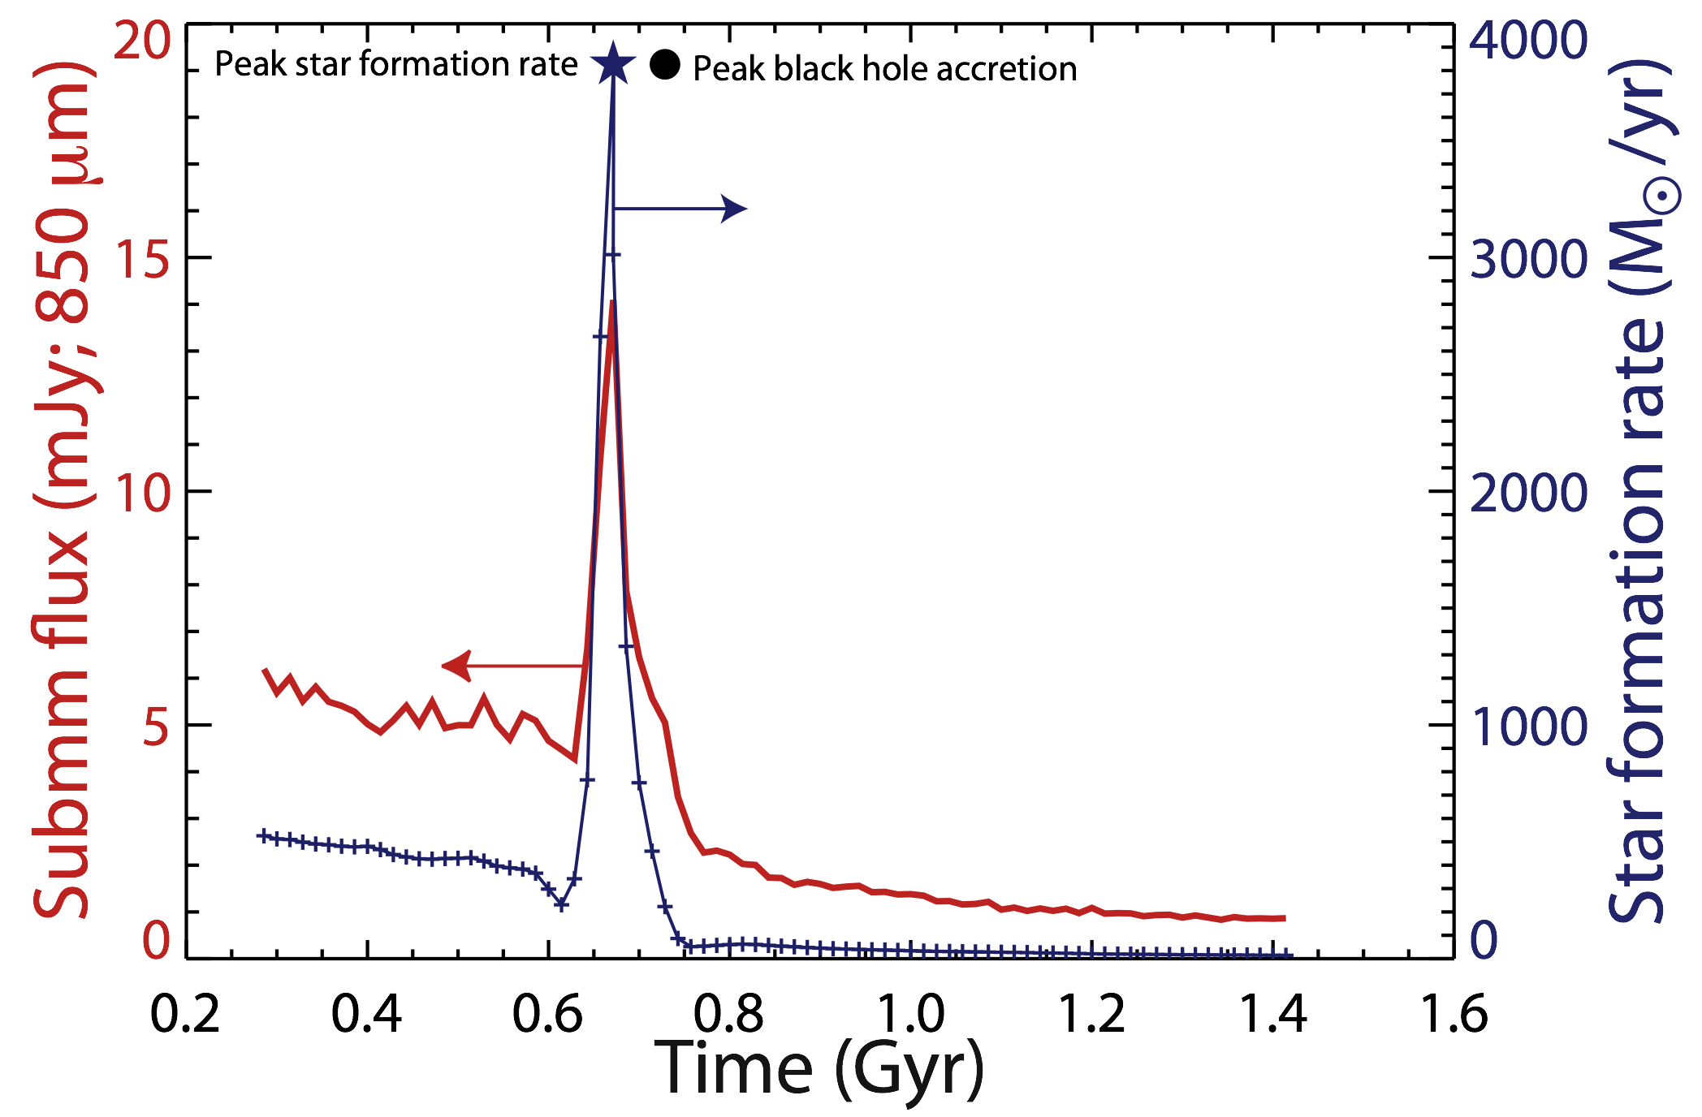
Evolution of a massive merger
Interacting galaxies
NGC 4038/9
Final coalescence
Arp 220; GOODS 850-5
(Flux calculated for z = 2)
Narayanan et al. 2009, arXiv:0904.0004
Notes:
Submm observations are essential in order to understand how and when the stars and the central black holes in galaxies were formed.
This simulation (Narayanan et al 2009 – Hernquist group) is for a 1:1 merger of 1E13 Msolar halos

Slide 17
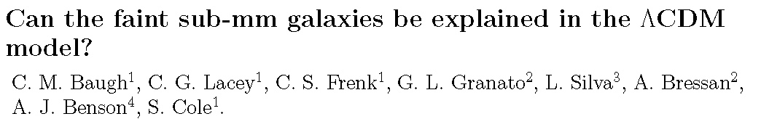
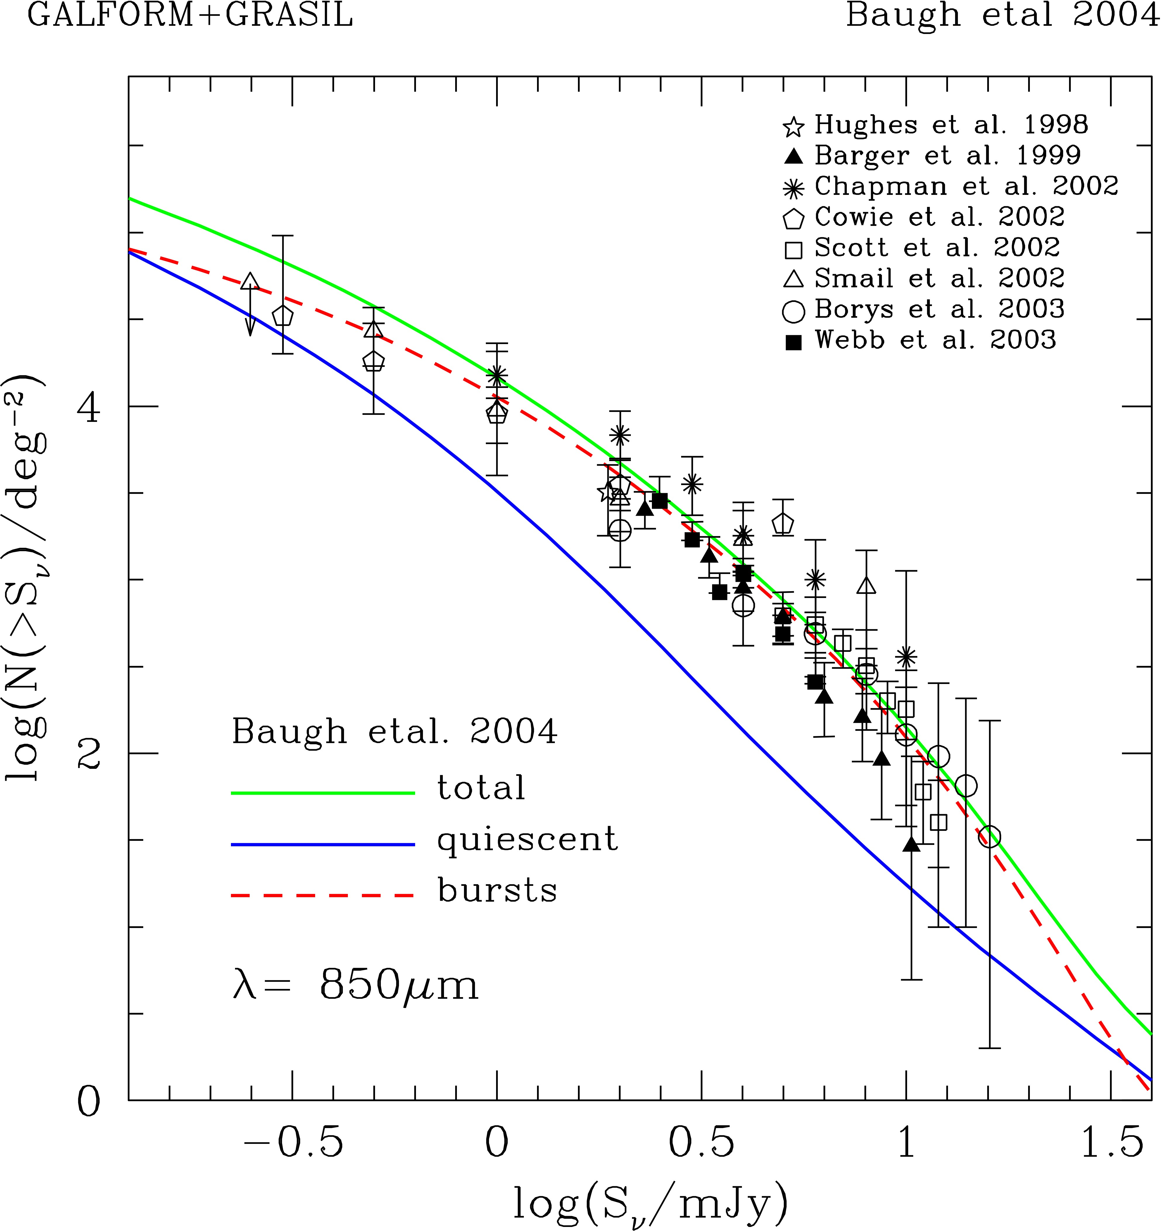
Explaining SMGs: semi-analytic model
MNRAS 2005
Semianalytical model
CDM halo “merger tree”
Gas cooling, star formation, feedback, …
Treat chemical evolution, dust production, dust radiative transfer
Includes galaxy mergers & starbursts
Number counts OK
Submm galaxies dominated by mergers

Slide 18
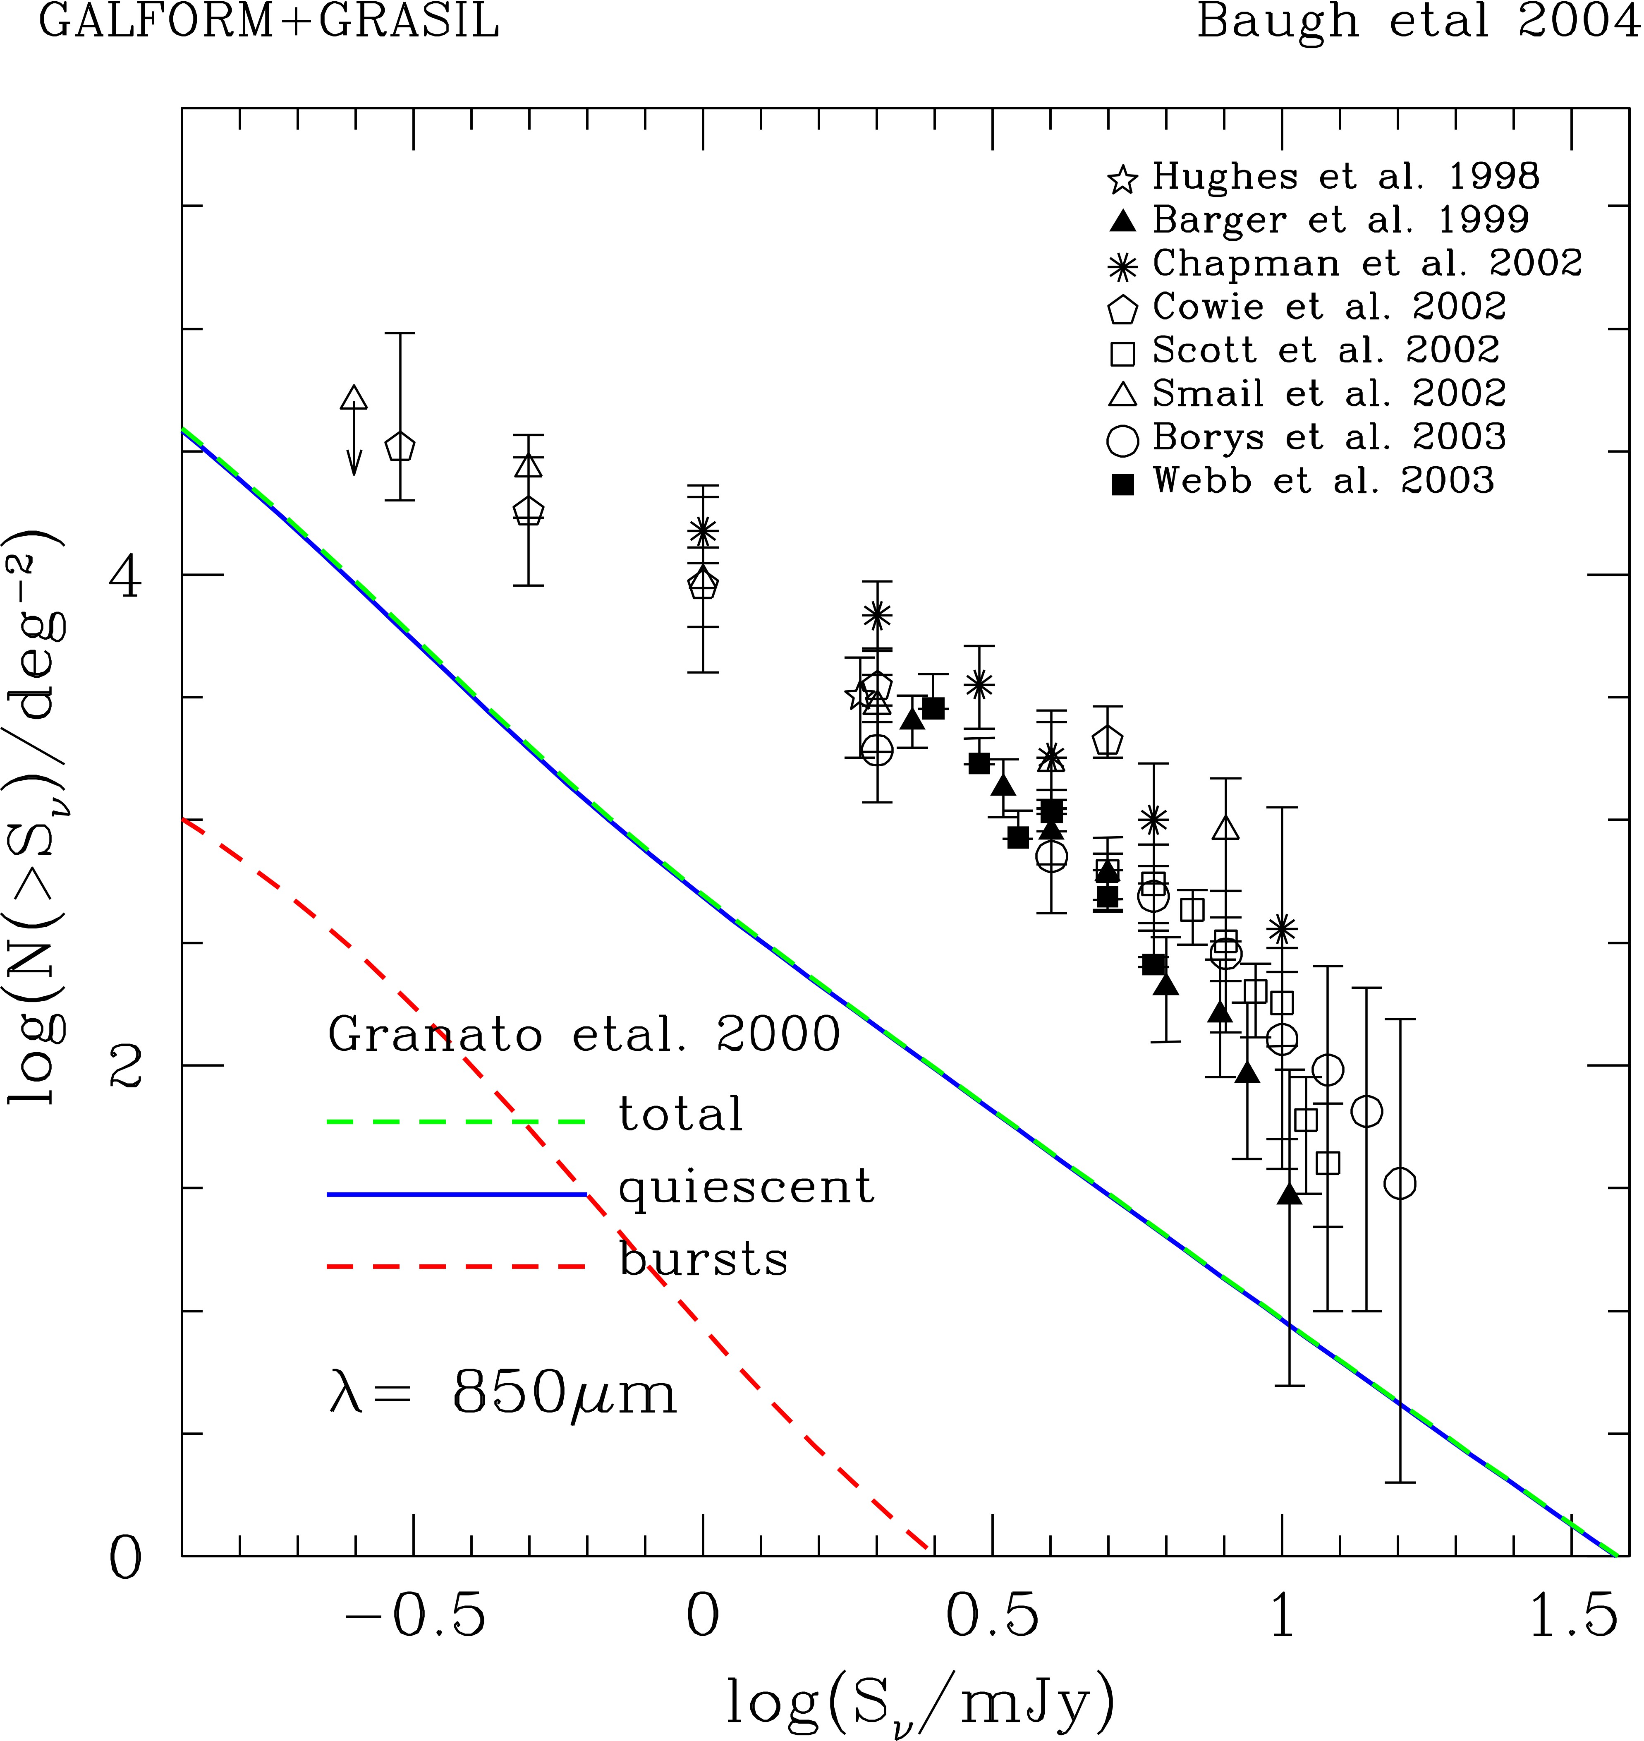
Explaining SMGs
Original model, pre-submm
Tuned to match optical/IR properties of local galaxies…
…but severely underpredicts submm galaxies!
Fixes:
  Slower star formation in disks
  Minor mergers lead to starbursts
  Use flat IMF for starbursts
Metallicity OK for cluster gas, ellipticals (Nagashima et al., 2005)

Slide 19
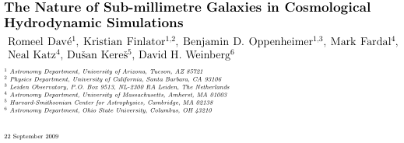
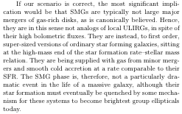
Are SMGs really mergers ?

Slide 20
Wish List
Larger & deeper surveys
  Less extreme objects, lower SFR
  Luminosity function vs z, with good SNR and dynamic range
  Clustering studies (vs z, SFR)
  Rare objects - dig deep into high redshift tail (z > 5)
Multiwavelength coverage
  Cover SED peak at z~2 to pin down SFR
  Use multicolor information for selecting objects for further study, e.g. high-z tail
Better angular resolution
  Essential for source ID and follow-up at other wavelengths
  Confusion limit
Fast redshift capability

Slide 21
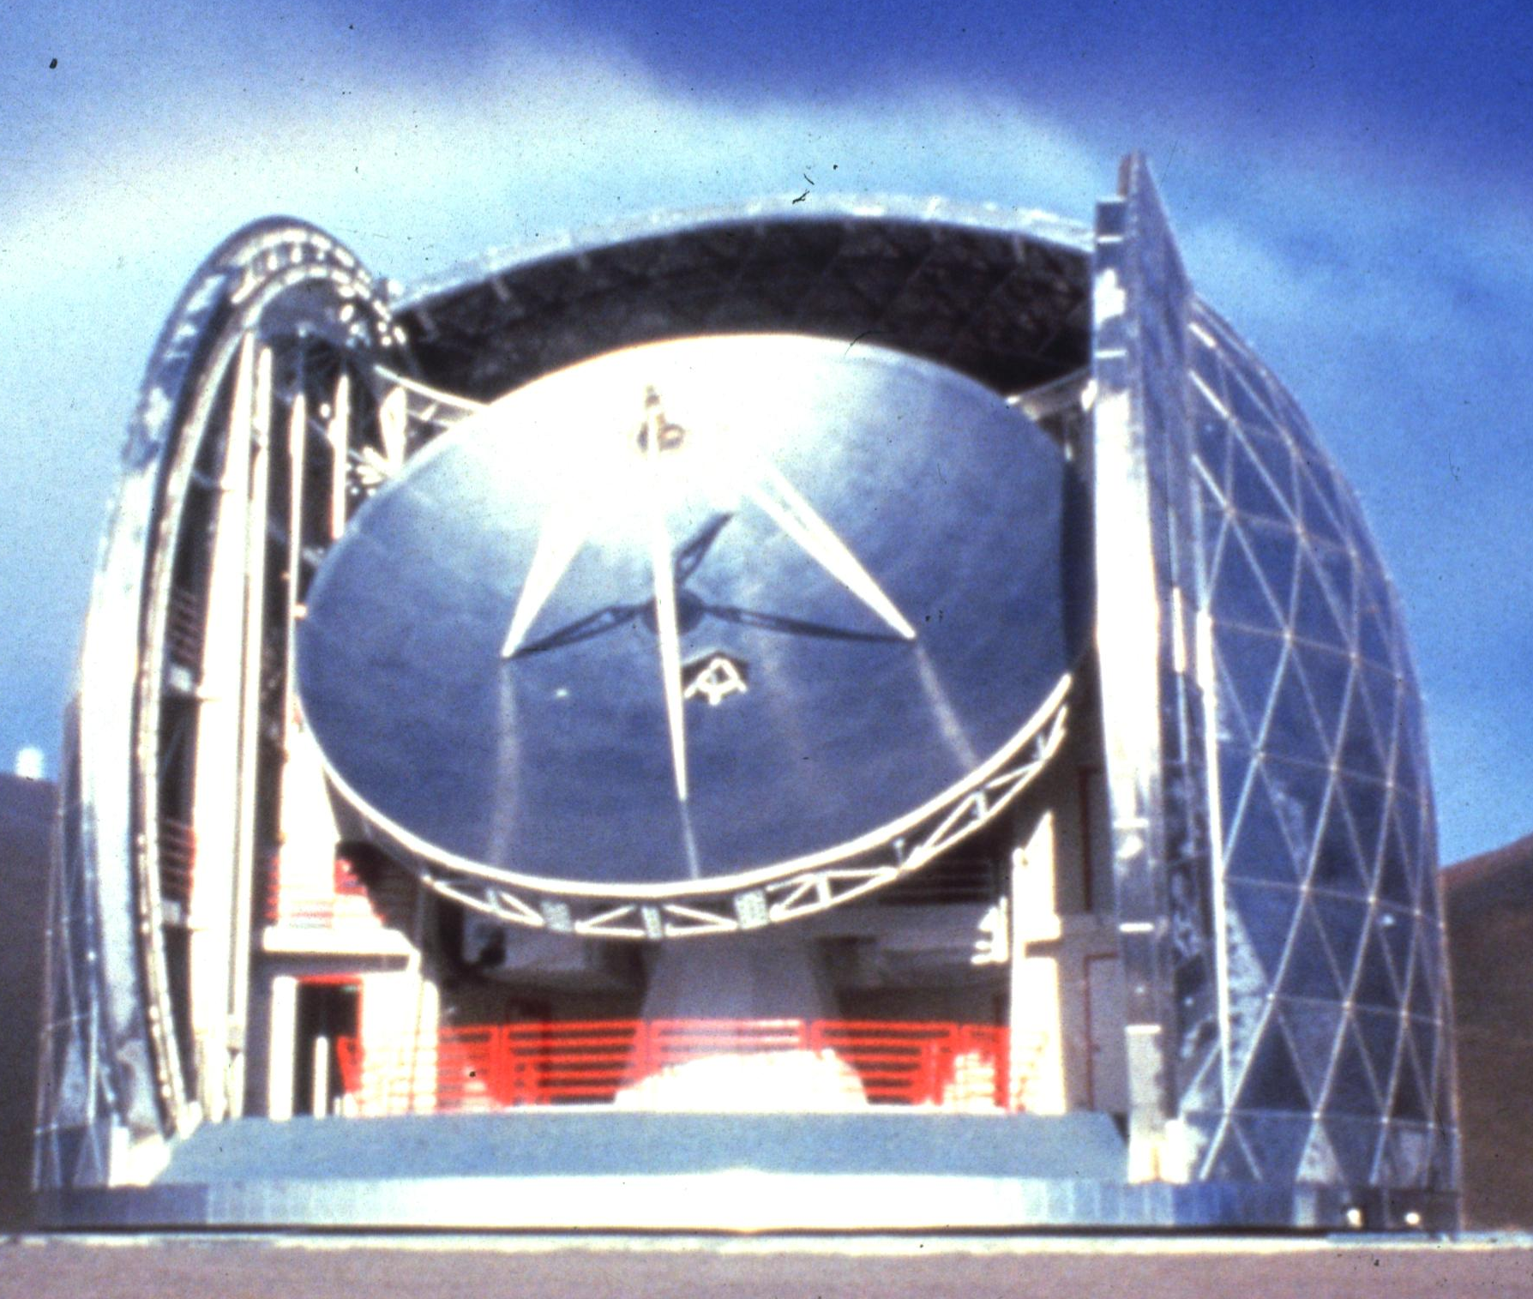
CSO and CCAT
Notes:
21

Slide 22
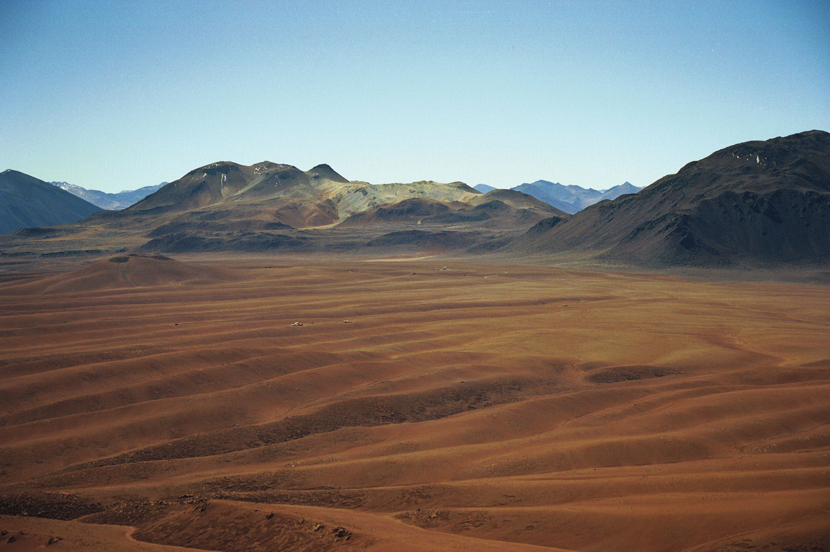
Chajnantor Plateau (5000 m)
Cerro Chajnantor
CCAT
CBI
ALMA
Dietrich/Caltech

Slide 23
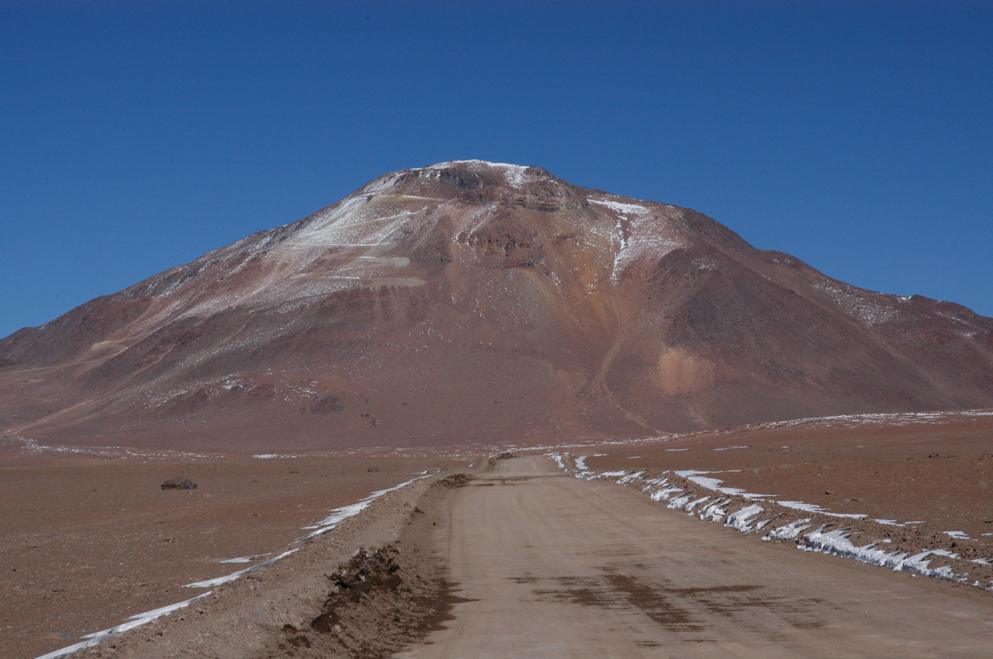
Cerro Chajnantor 5612 m
G. Gull/Cornell

Slide 24
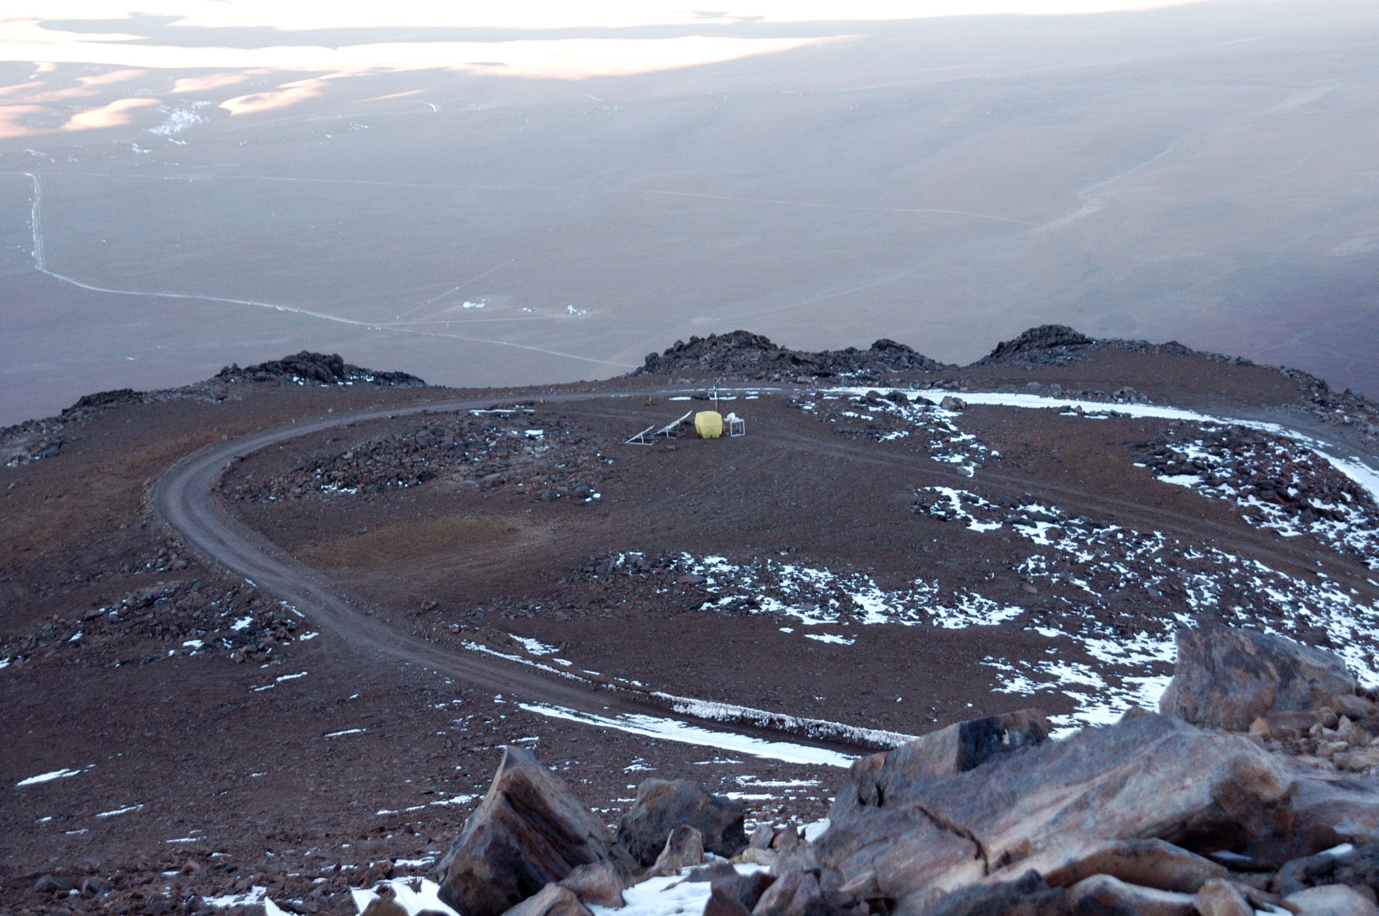
Cerro Chajnantor 5612 m
G. Gull/Cornell

Slide 25
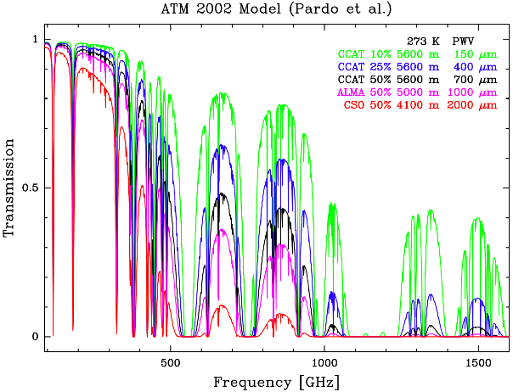
Atmospheric Transmission (model)
600 µm
200 µm

Slide 26
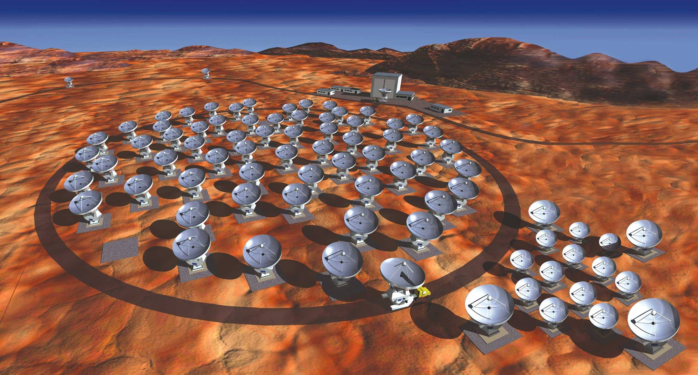
Atacama Large Millimeter Array
ALMA
54 12-m diameter antennas
Atacama Compact Array
12 7-m antennas
Chajnantor: 5000m elevation

Slide 27
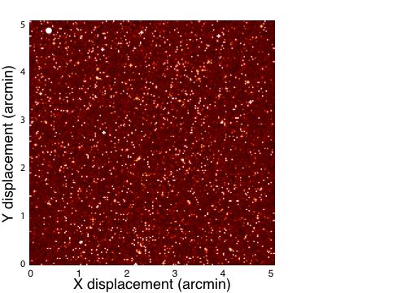
CCAT & ALMA
CCAT’s instantaneous field of view (350 μm, 40 kpixel camera)
ALMA field of view at 350 μm
Herschel resolution at 350 μm

Slide 28
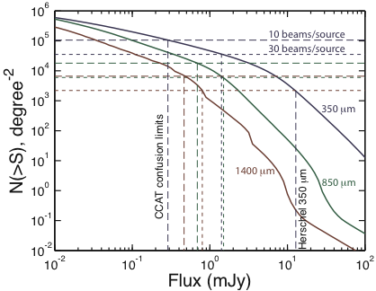
Confusion Limit
Lagache G., Dole, H. Puget J-L., et al, 2004 http://www.ias.u-psud.fr/irgalaxies

Slide 29
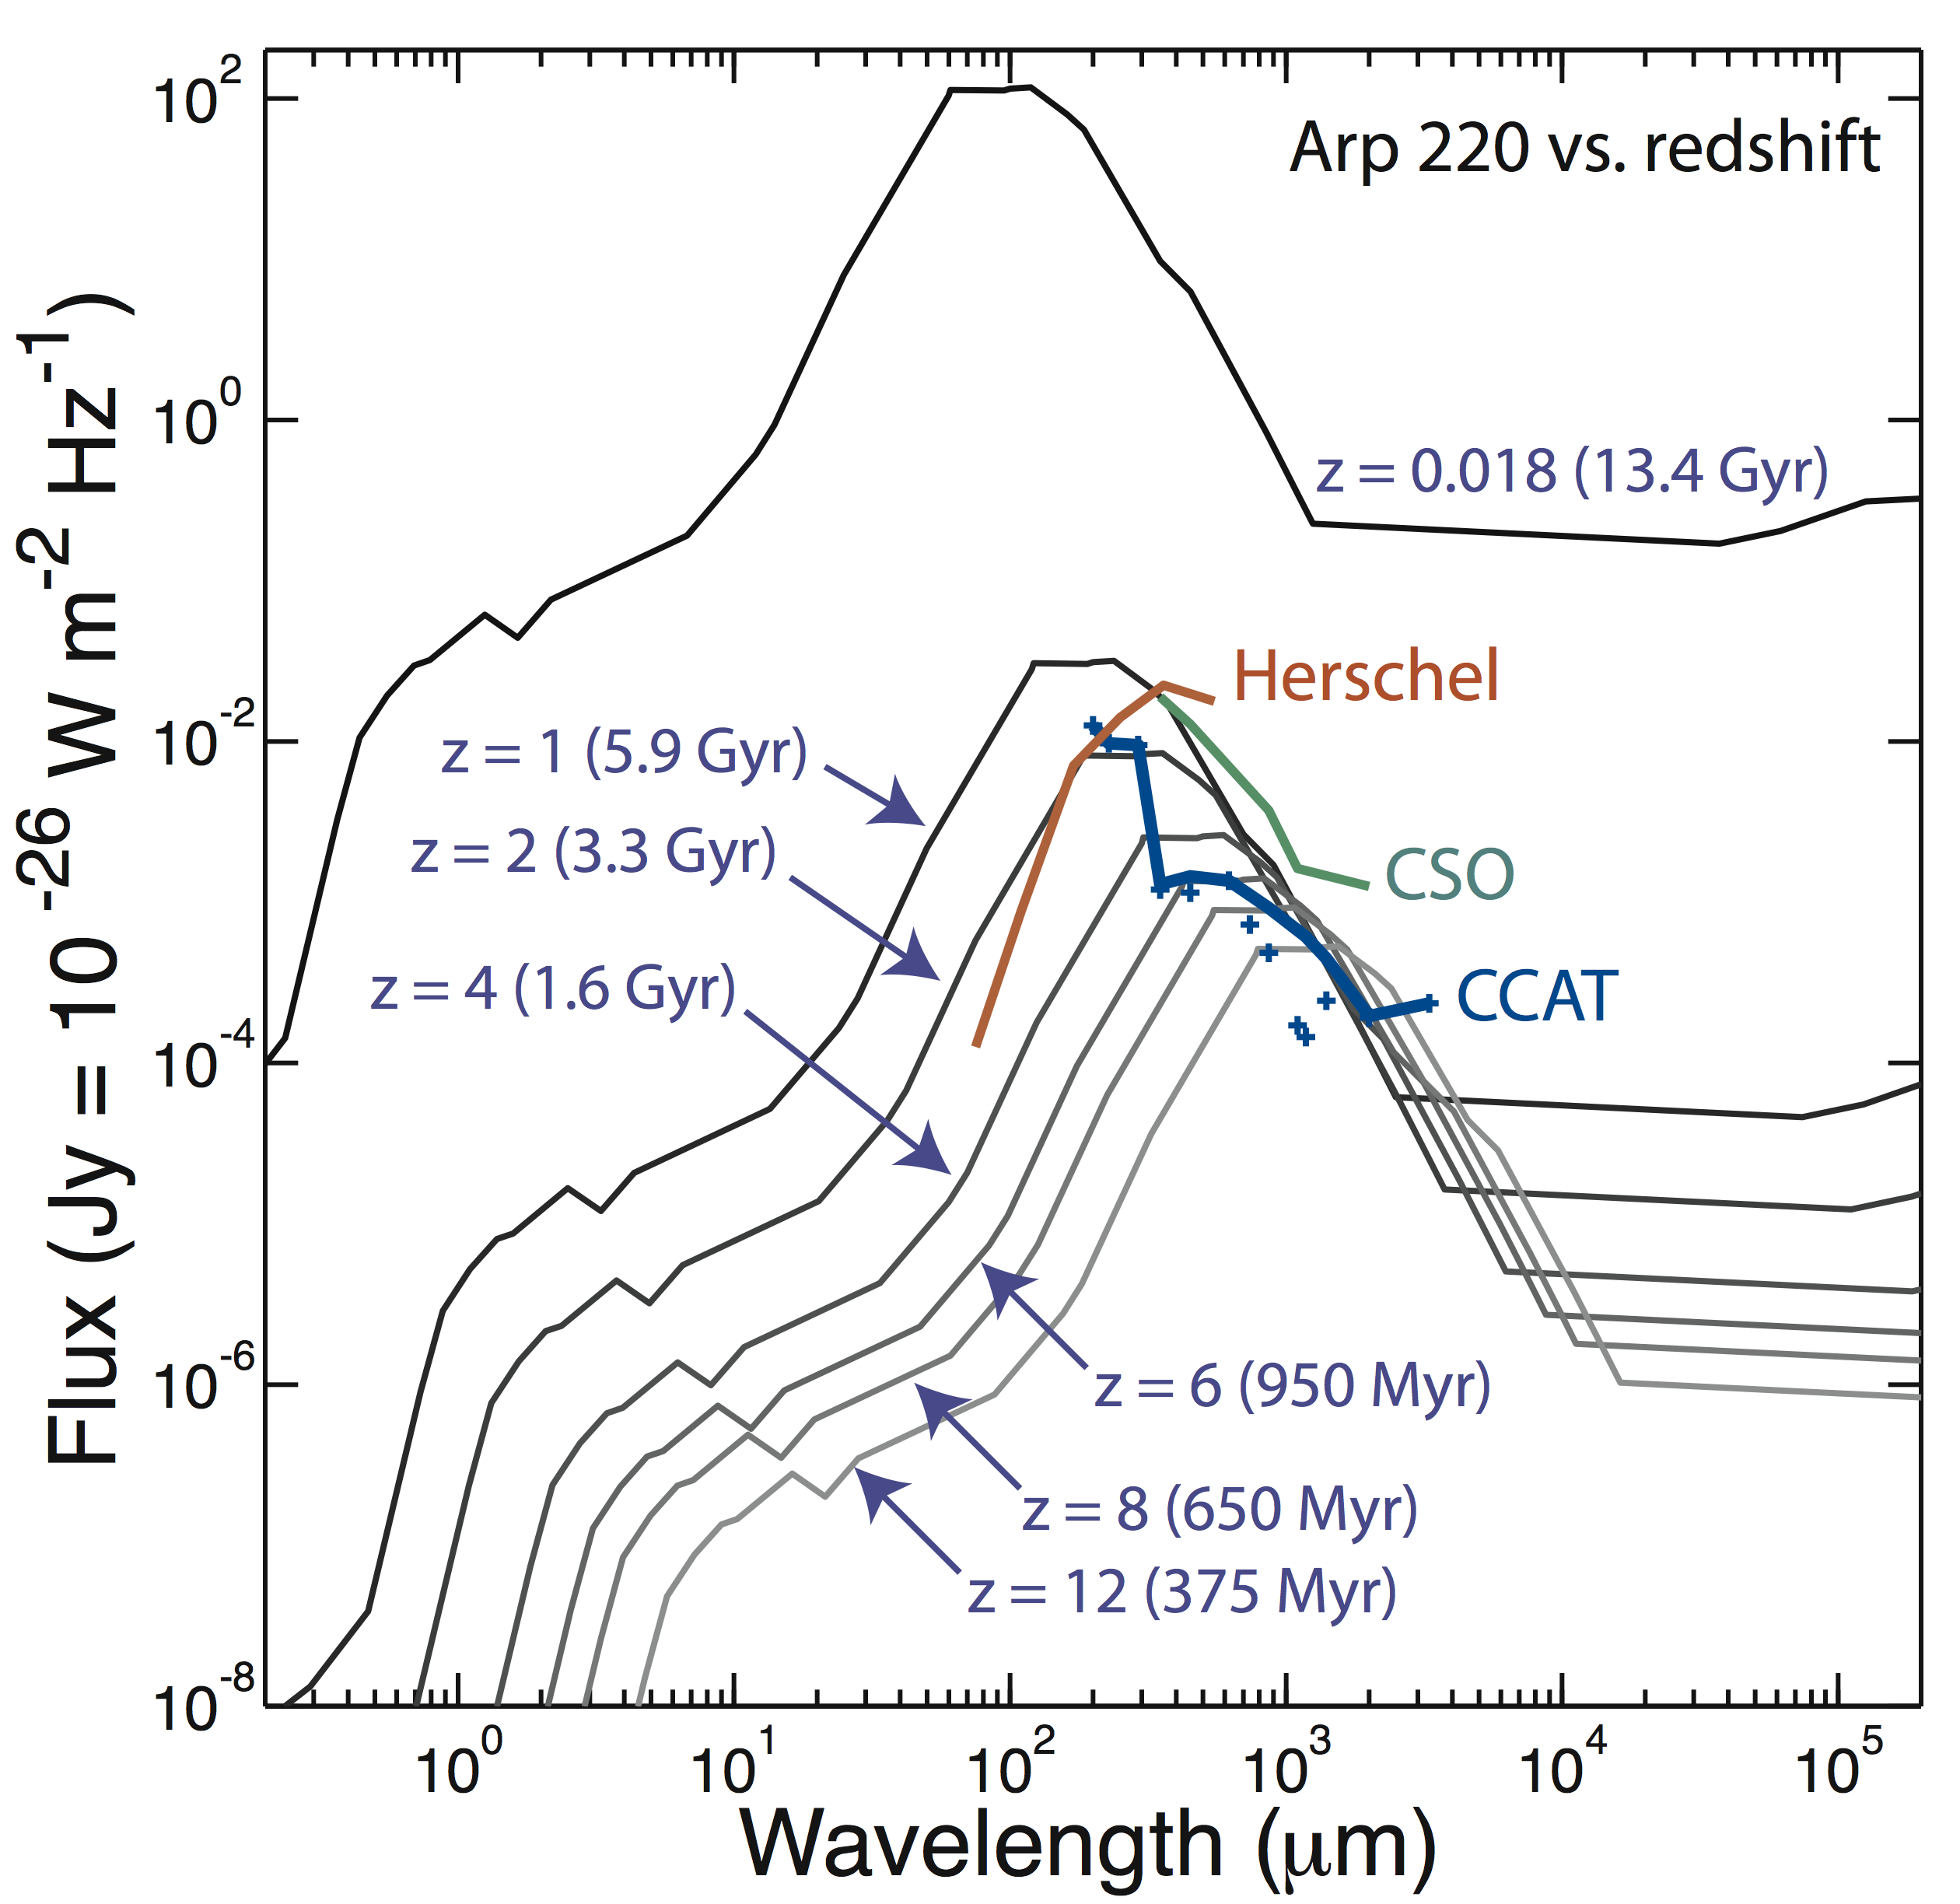
CCAT is sensitive enough to find galaxies like Arp 220 over the entire cosmic history of galaxy formation and evolution, to z>10
CCAT can find both early-phase and late-phase mergers (10¹¹ L at z=2)
CCAT’s extremely rapid survey speed will allow significant numbers of z > 5 objects to be detected
CCAT’s broad wavelength coverage allows efficient selection of z = 5-10 candidates
Redshifts can be obtained using CCAT, equipped with a multi-object spectrometer
CCAT’s good angular resolution is essential for follow-up observations

Slide 30
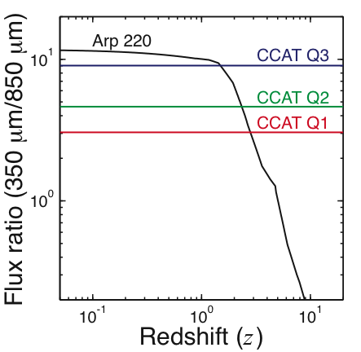
Selecting high-redshift candidates

Slide 31
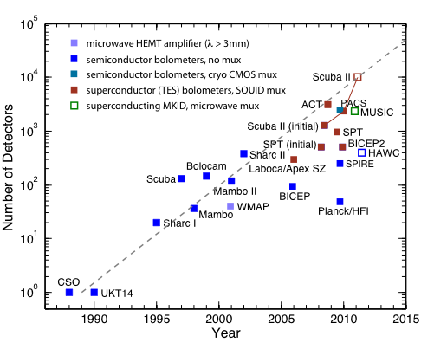
Submm array detectors enable CCAT
CCAT

Slide 32
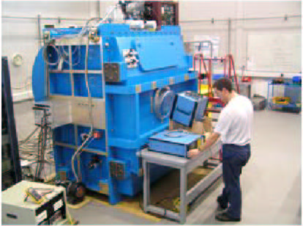
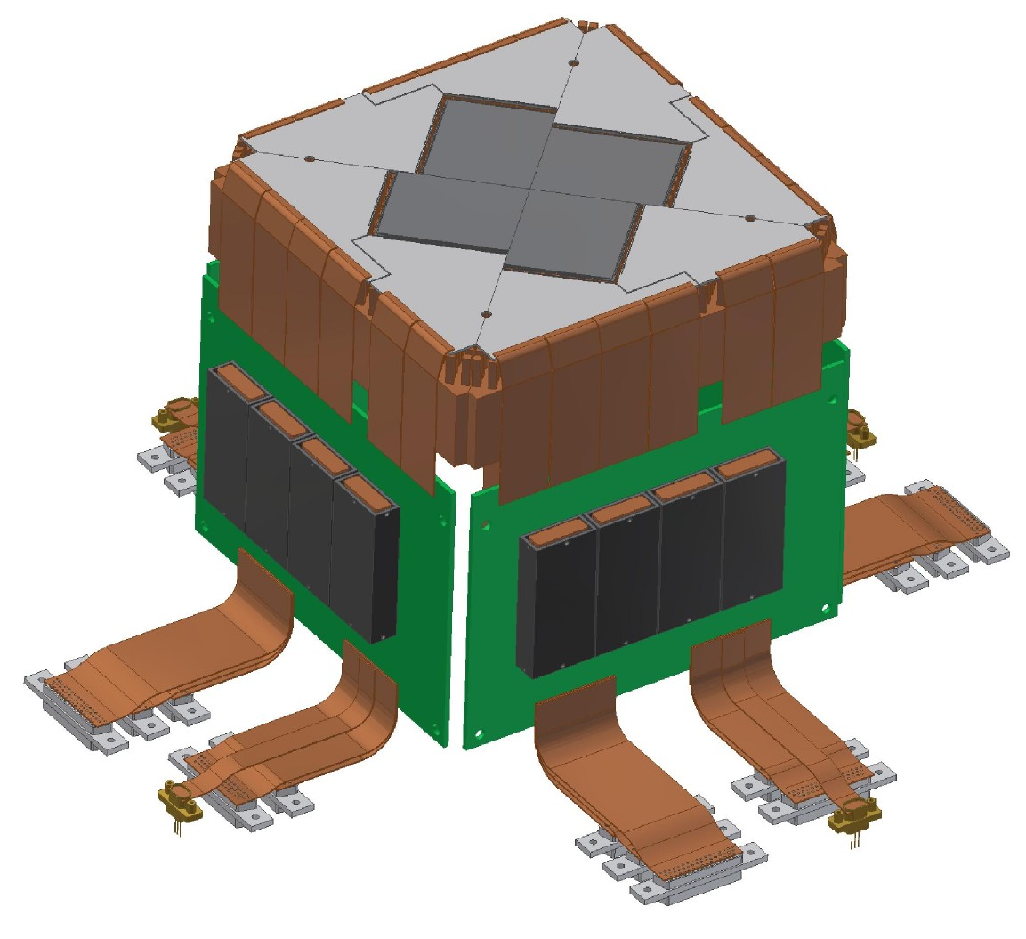

UK’s SCUBA 2: return of the superconducting bolometer !
5000 close-packed TES pixels per band (450/850 μm)
Voltage-biased TES: Irwin 1995 (Stanford)
SQUID TDM mux: Chervenak et al 1999 (NIST)
Credit: W. Holland, UKATC
Niobium
Flex Cable
Ceramic PCB
40x32 sub-array
SQUID
Series
Array
Amplifiers
SCUBA 2 SQUID TDM mux wafer (NIST)
Ribbon Cables to Room Temperature

Slide 33

SCUBA 2 Multiplexer
It’s getting complicated…

Slide 34


1961: STJ detector proposed

Slide 35




1958: Mattis & Bardeen
absorption
emission
Pair breaking
Kinetic inductance
Implementation ?

Slide 36

MKIDs: superconducting microresonator detectors
Proposal (JPL DRDF):
Zmuidzinas & Leduc 1999
Proof of concept:
Day et al. 2003, Nature 425, 817

Slide 37



Far-IR TiN MKID Array
Cardiff “LEKID” geometry, Doyle et al.

Slide 38


MKID Sensitivity
TiN CPW resonator
Q_{r}=40,000, 3f_{r}=5.4 GHz, t=20 nm, T_{c}=1.1 K, w=3 μm, g=2 μm, α=0.95, P_{gen}=5 - 200 fW
Frequency noise - surface distribution of
TLS fluctuators:
Gao et al. 2008, APL 92, 212504
Noise reduction:
Noroozian et al 2009, AIP Conf. Ser. 1185

Slide 39


Multiplexing
SiGe cyrogenic bipolar amp: Joe Bardin and Sandy Weinreb (Caltech)

Slide 40



Multichannel Readout Electronics
Omnisys AB, Gothenburg Sweden

Slide 41
Forecast
2D MKID detector arrays will be abundant and inexpensive
  TiN deposition, patterning & etching: < 4 hours
  Standard wafer thickness, very robust mechanically
  Backside illumination, AR coat with Parylene (used for circuit boards)
  Packaging requires only a few wire bonds per array
MKID readout electronics will be inexpensive
  Uses standard commercial silicon ICs
  Existing FPGAs can compute > 10⁸ point FFTs
Cryo-amplifiers based on SiGe will be inexpensive
  Commercial, high-volume process instead of InP HEMT
Conclusion:
  Submm detectors will not be a limitation for CCAT
  Feasibility study was limited to 40 kpixels
  CCAT science case needs to be revisited and updated

Slide 42


CCAT with CFRP truss
Clearance for 1deg FoV
Deep, stiff truss,
natural frequency 11Hz
3-point AZ support for small pointing error

Slide 43

CCAT 1° FoV instrument layout
Need 50-100 sub fields for 1° FoV
in, e.g., 7 or 19 close-packed cryostats.
4-5’ sub fields are consistent with existing lens, filter & window designs.
4’ field is 175mm diameter at Naysmith. Can buy high-resistivity Si up to 200mm diameter.
Sub-field camera

Slide 44

CCAT compound panel details
Manual adjuster
Edge sensor
Actuator
From Woody et al. SPIE 7018, 2008
Study contract to GD/Vertex (Duisburg)

Slide 45


WaFIRS compact waveguide spectrometer
curved grating in parallel plate waveguide
Propagation confined in parallel-plate waveguide
  2-D Geometry
  Stray light eliminated
Curved grating diffracts and focuses
  Efficient use of space
  No additional optical elements
H.A. Rowland, 1883, Phil. Mag 16
K.A. McGreer, 1996, IEEE Phot. Tech. 8

Slide 46

Z-Spec: wideband direct detection spectroscopy
WaFIRS Grating:
62 × 48 × 3.3 cm
Parameters
λ = 1.0 to 1.5 mm (CSO)
160 bolometers
Δν ~ 900 MHz, Δv ~ 1,000 km s⁻¹
Compact, stackable waveguide-coupled diffraction grating: technology demonstration for future instruments (e.g., BLISS, SAFIR, …)
Caltech—Bret Naylor, Jonas Zmuidzinas
Cardiff—Peter Ade
CEA (France)—Lionel Duband
Colorado—James Aguirre, Lieko Earle, Jason Glenn, Phil Maloney, Corey Wood
JPL—Jamie Bock, Matt Bradford, Hien Nguyen
ISAS (Japan)—Hideo Matsuhara
³He/⁴He Fridge
60 mK ADR
(Salt pill courtesy Peter Timbie’s group)

Slide 47


Z-Spec high-redshift measurements
HST optical
Cloverleaf host galaxy:
A powerful lensed system, originally detected in submillimeter (redshifted dust) by Barvainis et al. (1992).
* CO 4-3 and 7-6 detected with IRAM 30m and PdB interferometer (same group in 1994).
Z-Spec at CSO:
3 new lines including 2 highest-J transitions!
Bradford et al. 2009, ApJ (in press)

Slide 48


Alternative concepts for submm MOS
Planar superconducting spectrometer
Moseley et al. uSPEC proposal – SPICA instrument
(also Zmuidzinas & Schoelkopf, 1999)
Cross-dispersed silicon gratings
IR version: D. Jaffe et al.

Slide 49

C+ can be used for redshifts with CCAT

Slide 50
Other science topics
Star formation
  Survey for cold prestellar cores
  Does stellar IMF follow the core mass function?
Debris disks
  Imaging at 3”.5 resolution
  Searching for debris disks in stellar clusters (requires wide FOV)
Outer solar system - TNOs
Sunyaev-Zeldovich surveys
GRBs ?

Slide 51

Debris Disks
40”
Image of Fomalhaut debris disk acquired with the CSO/SHARC II (Marsh et al. 2005, ApJ, 620, L47). Left: The observed image which has 10″ resolution and shows a complete ring of debris around the star. Right: A resolution enhanced image with 3″ resolution. CCAT will have this resolution intrinsically, with the capability to achieve ~1″ resolution through image enhancement techniques. From the CSO image, we can already infer the presence of a planet due to the asymmetry of the ring. CCAT imaging should show substructure which will pinpoint the location of the planet. The vertical bars in each image are 40″ in length.

Slide 52




TNOs with CCAT

Slide 53

TNOs with CCAT

Slide 54

SZ Surveys with CCAT ?
Lueker et al 2009: SPT results
CCAT: 3x better angular resolution, multiple wavelength channels, 10x AΩ

Slide 55



very high-z GRB afterglows
Inoue, Omukai & Ciardi, astro-ph/0502218
spectra
spectra
light curve
GRBs at t~few hr are brightest in mm-IR
peak flux 0.1-1 mJy, nearly constant
for z~5-30 (redshift+time dilation)
ALMA should detect GRBs from z~30!
(current record: z=8)
Inoue 2007

Slide 56


absorption lines in GRB spectra
Inoue, Omukai & Ciardi, astro-ph/0502218
ALMA:
HD
CO (high)
[OI]
probe Pop III
probe physical conditions (different J),
Pop III->II transition
Inoue 2007

Slide 57




observing strategy
3m class NIR telescope e.g.
SWIFT
New Okayama Telescope
GRB
burst alert
GRB
arcmin(sec) location
arcsec location
~min
high-z selection
(photo-z)
~hour
CCAT imaging
CCAT wideband spectroscopy
EXCITING
NEW SCIENCE!
ALMA
spectroscopic z
opt./IR science
Subaru
~day
Inoue 2007

Slide 58
Summary
Science at submillimeter wavelengths is rich and compelling
  Solar system, star & planet formation, galaxy formation and evolution, cosmology
Submillimeter astronomy is entering a new phase
  Detector arrays will be cheap and plentiful
  Will enable megapixel cameras, multi-object spectrometers
CCAT is designed to capitalize on advances in submm detector arrays
  Large, highly accurate single dish
  Excellent site
  Maximum available FOV
There’s a lot of work to be done:
  Revisit instrumentation plan: camera evolution, MOS
  Update CCAT science case to exploit new instrumentation
  Build CCAT !

